Slide 1
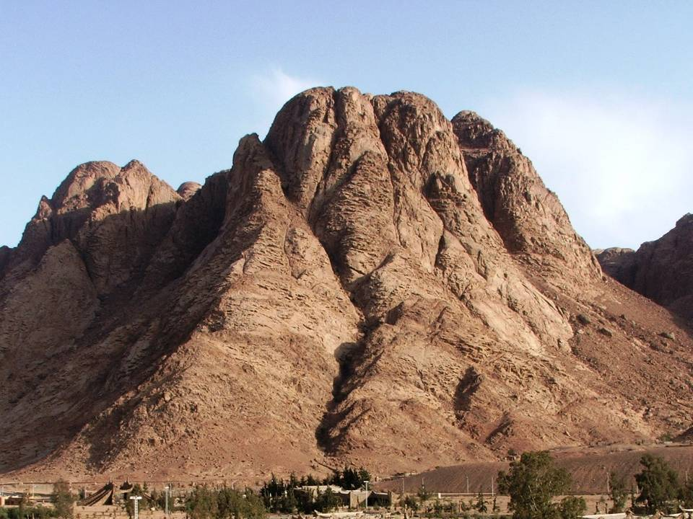
Old Testament
Exodus – Deuteronomy
November 4, 2016
Lakeside Institute of Theology
Ross Arnold, Fall 2016

Slide 2
Torah
The First Five Books of the Old Testament
Hebrew: “Law, Instruction”
Pentateuch
Greek: “Five-Part Book”

Slide 3
Numbers
Genesis
From creation thru the origins of God’s people to Egypt
Exodus
Relates God’s deliverance of Israel from Egypt and establishing His covenant/Law
Leviticus
Sets forth the Laws of worship
Relates the wilderness wanderings
Deuteronomy
Gives the Law to a new generation with special emphasis to those entering the land

Slide 4
The Book of Exodus
Author: Moses
Date: circa 1446 BC - 1440 BC
Theme: God’s deliverance of His Chosen people.
Key Word: Redemption
Purpose: To show God’s faithfulness to His covenant & give directions for living.
Outline: Moses (1-7)
The Plagues (7-13)
The Exodus from Egypt (14-18)
The Law (19-24)
Tabernacle & Worship (25-40)

Slide 5
The Book of Exodus
Focus
Redemption from Egypt
Revelation from God
Reference
1:1----- 2:1--------5:1-------15:22------19:1--------32:1-----40:38
Division
Need for Redemption
Preparation for Redemption
Redemption
of Israel
Preservation of Israel
Revelation of the Covenant
Response of Israel to the Covenant
Topic
Narration
Legislation
Subjection
Redemption
Instruction
Location
Egypt
Wilderness
Mount Sinai
Time
430 Years
2 Months
10 Months

Slide 6
Major Events in Exodus
Oppression of the Israelites
Then a new king, who did not know about Joseph, came to power in Egypt. ⁹ "Look," he said to his people, "the Israelites have become much too numerous for us. ¹⁰ Come, we must deal shrewdly with them or they will become even more numerous and, if war breaks out, will join our enemies, fight against us and leave the country."
¹¹ So they put slave masters over them to oppress them with forced labor, and they built Pithom and Rameses as store cities for Pharaoh. ¹² But the more they were oppressed, the more they multiplied and spread; so the Egyptians came to dread the Israelites ¹³ and worked them ruthlessly. ¹⁴ They made their lives bitter with hard labor in brick and mortar and with all kinds of work in the fields; in all their hard labor the Egyptians used them ruthlessly.
¹⁵ The king of Egypt said to the Hebrew midwives, whose names were Shiphrah and Puah, ¹⁶ "When you help the Hebrew women in childbirth and observe them on the delivery stool, if it is a boy, kill him; but if it is a girl, let her live." Exodus 1:8-16

Slide 7
Major Events in Exodus
Birth & Preservation of Moses
Now a man of the house of Levi married a Levite woman, ² and she became pregnant and gave birth to a son. When she saw that he was a fine child, she hid him for three months. ³ But when she could hide him no longer, she got a papyrus basket for him and coated it with tar and pitch. Then she placed the child in it and put it among the reeds along the bank of the Nile. ⁴ His sister stood at a distance to see what would happen to him.
⁵ Then Pharaoh's daughter went down to the Nile to bathe, and her attendants were walking along the river bank. She saw the basket among the reeds and sent her slave girl to get it. ⁶ She opened it and saw the baby. He was crying, and she felt sorry for him. "This is one of the Hebrew babies," she said. …
¹⁰ When the child grew older, she took him to Pharaoh's daughter and he became her son. She named him Moses, saying, "I drew him out of the water." Exodus 2:1-10

Slide 8
Major Events in Exodus
Flight of Moses to Midian
One day, after Moses had grown up, he went out to where his own people were and watched them at their hard labor. He saw an Egyptian beating a Hebrew, one of his own people. ¹² Glancing this way and that and seeing no one, he killed the Egyptian and hid him in the sand. ¹³ The next day he went out and saw two Hebrews fighting. He asked the one in the wrong, "Why are you hitting your fellow Hebrew?"
¹⁴ The man said, "Who made you ruler and judge over us? Are you thinking of killing me as you killed the Egyptian?" Then Moses was afraid and thought, "What I did must have become known."
¹⁵ When Pharaoh heard of this, he tried to kill Moses, but Moses fled from Pharaoh and went to live in Midian, where he sat down by a well. Exodus 2:11-16

Slide 9
Major Events in Exodus
The Burning Bush
Now Moses was tending the flock of Jethro his father-in-law, the priest of Midian, and he led the flock to the far side of the desert and came to Horeb, the mountain of God. 2 There the angel of the Lord appeared to him in flames of fire from within a bush. Moses saw that though the bush was on fire it did not burn up. 3 So Moses thought, "I will go over and see this strange sight - why the bush does not burn up."
4 When the Lord saw that he had gone over to look, God called to him from within the bush, "Moses! Moses!“
And Moses said, "Here I am."
"Do not come any closer," God said. "Take off your sandals, for the place where you are standing is holy ground." 6 Then he said, "I am the God of your father, the God of Abraham, the God of Isaac and the God of Jacob." At this, Moses hid his face, because he was afraid to look at God.
Exodus 3:5-6

Slide 10
Major Events in Exodus
The Call of Moses
The Lord said, "I have indeed seen the misery of my people in Egypt. I have heard them crying out because of their slave drivers, and I am concerned about their suffering. ⁸ So I have come down to rescue them from the hand of the Egyptians and to bring them up out of that land into a good and spacious land, a land flowing with milk and honey …. ⁹ And now the cry of the Israelites has reached me, and I have seen the way the Egyptians are oppressing them. ¹⁰ So now, go. I am sending you to Pharaoh to bring my people the Israelites out of Egypt." ¹¹ But Moses said to God, "Who am I, that I should go to Pharaoh and bring the Israelites out of Egypt?"
¹² And God said, "I will be with you. And this will be the sign to you that it is I who have sent you: When you have brought the people out of Egypt, you will worship God on this mountain."
¹³ Moses said to God, "Suppose I go to the Israelites and say to them, 'The God of your fathers has sent me to you,' and they ask me, 'What is his name?' Then what shall I tell them?"
¹⁴ God said to Moses, "I AM WHO I AM. This is what you are to say to the Israelites: 'I AM has sent me to you.'" Exodus 3:1-14

Slide 11
Major Events in Exodus
The Plagues on Egypt
Plague #1 – Ex. 7:14-25 – Nile turns to blood.
Plague #2 – Ex. 8:1-15 – Frogs.
Plague #3 – Ex. 8:16-19 – Lice/gnats.
Plague #4 – Ex. 8:30-32 – Flies.
Plague #5 – Ex. 9:17 – Disease on cattle.
Plague #6 – Ex. 9:8-11 – Boils/sores on people & animals.
Plague #7 – Ex. 9:12-35 – Hail destroys crops & cattle.
Plague #8 – Ex. 10:1-20 – Locusts destroy crops.
Plague #9 – Ex. 10:21-29 – Darkness.
Plague #10 – Ex. 11:1-10 – Death of the Firstborn.

Slide 12
Major Events in Exodus
Crossing the Red Sea
Then Moses stretched out his hand over the sea, and all that night the Lord drove the sea back with a strong east wind and turned it into dry land. The waters were divided, ²² and the Israelites went through the sea on dry ground, with a wall of water on their right and on their left.
²³ The Egyptians pursued them, and all Pharaoh's horses and chariots and horsemen followed them into the sea. ²⁴ During the last watch of the night the Lord looked down from the pillar of fire and cloud at the Egyptian army and threw it into confusion. ²⁵ He made the wheels of their chariots come off so that they had difficulty driving. And the Egyptians said, "Let's get away from the Israelites! The Lord is fighting for them against Egypt."
²⁶ Then the Lord said to Moses, "Stretch out your hand over the sea so that the waters may flow back over the Egyptians and their chariots and horsemen." ²⁷ Moses stretched out his hand over the sea, and at daybreak the sea went back to its place. The Egyptians were fleeing toward it, and the Lord swept them into the sea. ²⁸ The water flowed back and covered the chariots and horsemen -- the entire army of Pharaoh that had followed the Israelites into the sea. Not one of them survived. Exodus 14:21-28

Slide 13
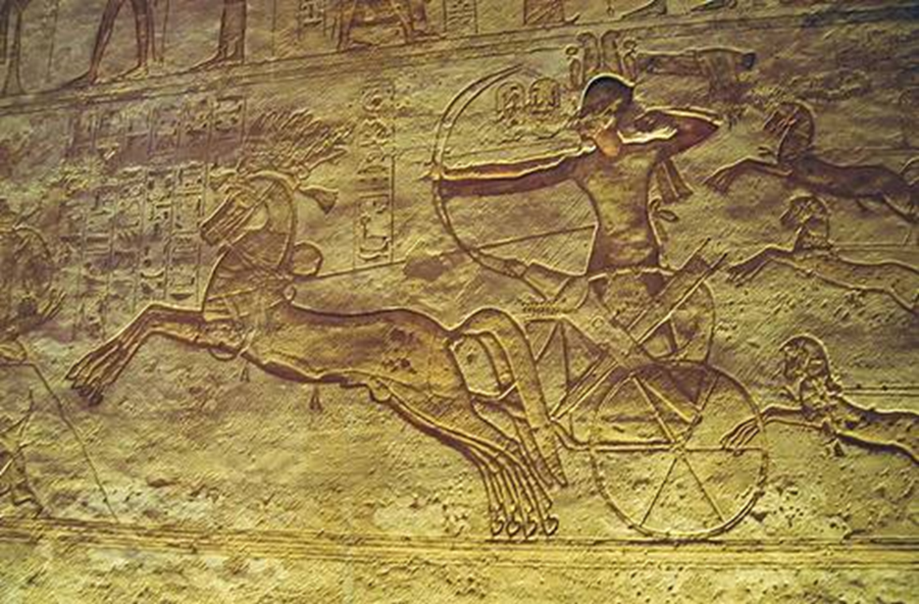

Slide 14
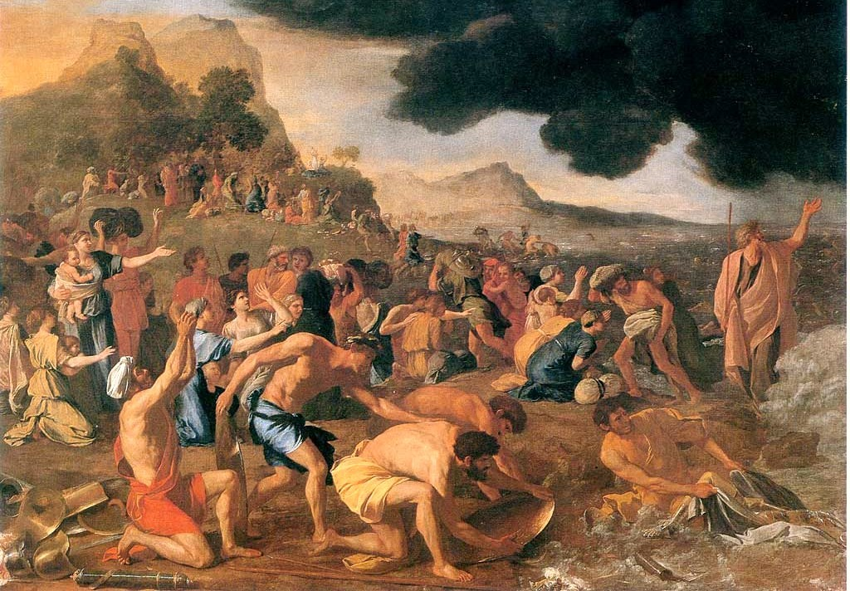

Slide 15
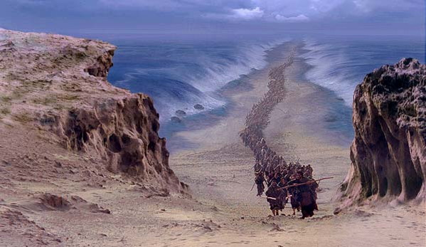

Slide 16
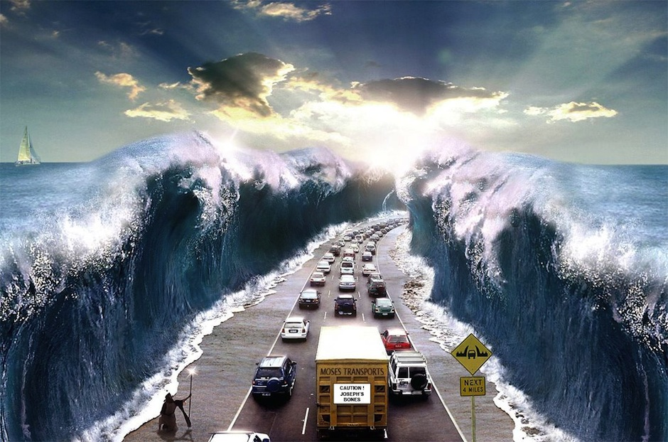

Slide 17
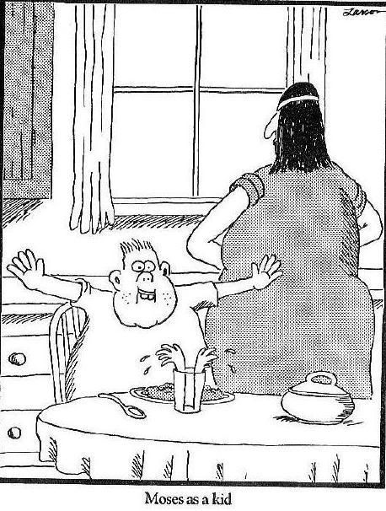

Slide 18
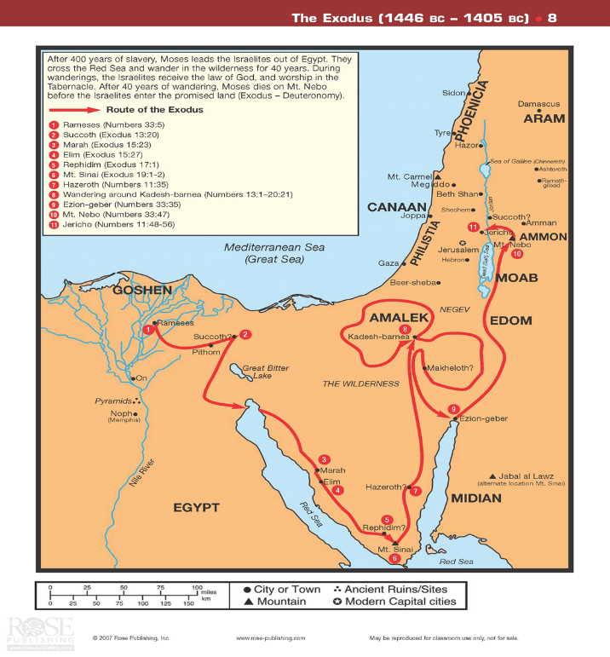

Slide 19
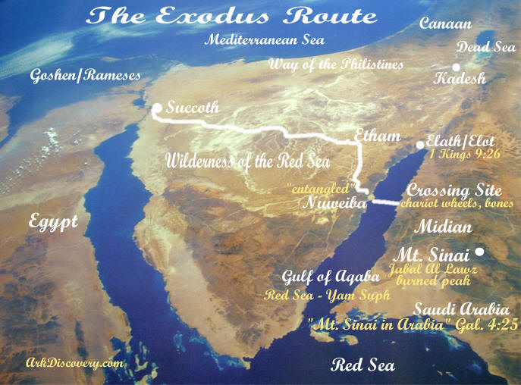

Slide 20
Major Events in Exodus
The Giving of the Law at Mount Sinai
The Ten Commandments
#1 – Ex. 20:3 – “no other gods before me.”
#2 – Ex. 20:4-6 – “do not make or worship idols.”
#3 – Ex. 20:7 – “do not misuse the name of God.”
#4 – Ex. 20:8-11-“remember the Sabbath; keep it holy.”
#5 – Ex. 20:12 – “honor your father and mother.”
#6 – Ex. 20:13 – “do not murder.”
#7 – Ex. 20:14 – “do not commit adultery.”
#8 – Ex. 20:15 – “do not steal.”
#9 – Ex. 20:16 – “do not give false testimony.”
#10 – Ex. 20:17 – “do not covet.”

Slide 21
Major Events in Exodus
Building of the Tabernacle & Ark of the Covenant
The Lord said to Moses, ² "Tell the Israelites to bring me an offering. You are to receive the offering for me from each man whose heart prompts him to give. ….
⁸ "Then have them make a sanctuary for me, and I will dwell among them. ⁹ Make this tabernacle and all its furnishings exactly like the pattern I will show you.
¹⁰ "Have them make a chest of acacia wood — two and a half cubits long, a cubit and a half wide, and a cubit and a half high. ¹¹ Overlay it with pure gold, both inside and out, and make a gold molding around it. ¹² Cast four gold rings for it and fasten them to its four feet, with two rings on one side and two rings on the other. ¹³ Then make poles of acacia wood and overlay them with gold. ¹⁴ Insert the poles into the rings on the sides of the chest to carry it. ¹⁵ The poles are to remain in the rings of this ark; they are not to be removed. ¹⁶ Then put in the ark the Testimony, which I will give you. Exodus 25:1-16

Slide 22
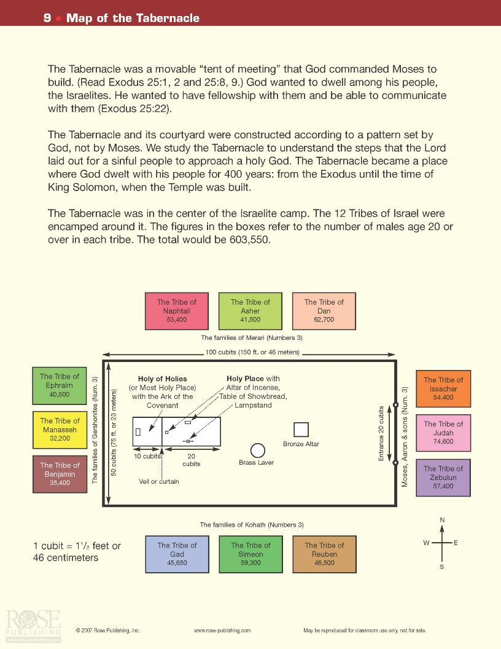

Slide 23
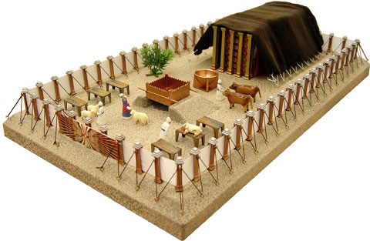

Slide 24
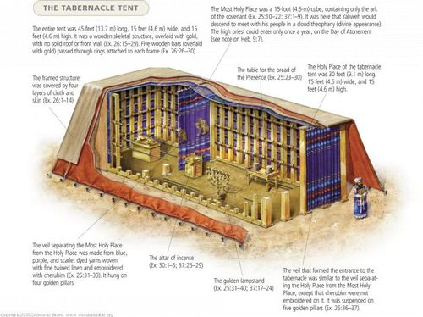

Slide 25
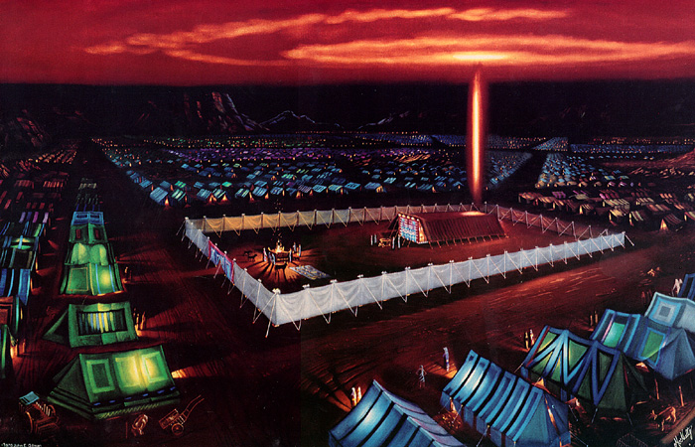

Slide 26
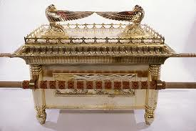

Slide 27
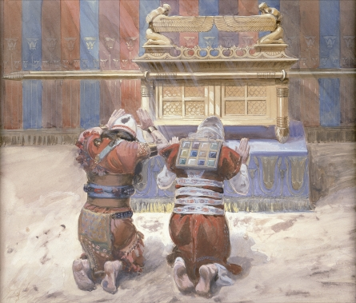

Slide 28
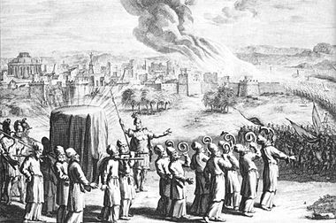

Slide 29
The Book of Leviticus
Author: Moses
Date: c. 1445 BC-1400 BC
Theme: Explanations of Law & Sacrifice.
Key Word: Holiness
Purpose: To instruct Israel on how to be holy & to be a blessing to others.
Outline: Sacrifice (chs. 1-7)
Priesthood (chs. 8-10)
Clean and unclean (chs. 11-15)
Day of Atonement (ch. 16)
Laws for daily life (chs. 17-27)

Slide 30
The Book of Leviticus
Focus
Sacrifice
Sanctification
Sanctification
Reference
1:1-------8:1---------11:1-------16:1--------18:1----21:1--23:1--25:1--27:1-27:34
Division
The Laws of Sacrifice
The Laws of Sanctification
The Offerings
Consecrating Priests
Consecrating the People
National Atonement
For the People
For Priests
In Worship
In Canaan
In Vows
Topic
The Way to God
The Walk with God
The Laws of Acceptable Approach to God
The Laws of Continued Fellowship
With God
Location
Mount Sinai
Time
c. 1 Month

Slide 31
The Book of Numbers
Author: Moses
Date: c. 1445 BC-1400 BC
Theme: Census and History
Key Word: Wanderings
Purpose: Show what can happen when God’s people rebel against Him.
Outline: Census (chs. 1-9)
Sinai to Canaan (chs. 10-12)
Spies and Rebellion (chs. 13-19)
At Moab (chs. 20-36)

Slide 32
The Book of Numbers
Focus
The Old Generation
The Tragic Transition
The New Generation
Reference
1:1-------5:1-------10:11---13:1----15:1-----20:1--26:1----28:1----31:1----36:13
Division
Organiza-tion of Israel
Sanctifica-tion of Israel
To Kadesh
At Kadesh
In the Wilder-ness
To Moab
Reorg. of Israel
Regulations: Offerings & Vows
Conquest & Division of Israel
Topic
Order
Disorder
Reorder
Preparation
Postponement
Preparation
Location
Mount Sinai
Wilderness
Plains of Moab
Time
20 Days
30 Years 3 Months 10 Days
c. 5 Months

Slide 34
The Book of Deuteronomy
Author: Moses
Date: c. 1401 BC-1400 BC
Theme: Three Sermons by Moses
Key Word: Covenant
Purpose: To remind the people of what God expects from them.
Outline: Sermon 1: Journey reviewed (1-4)
Sermon 2: Laws reviewed (5-28)
Sermon 3: Covenant (29-30)
Final Farewells (31-34)

Slide 35
The Book of Deuteronomy
Focus
First Sermon
Second Sermon
Third Sermon
Reference
1:1-------4:4--------12:1----16:18----21:1------27:1--------29:1------31:1---34:12
Division
Review of God’s Acts for Israel
Exposition of the Decalogue
Ceremonial Law
Civil Laws
Social Laws
Ratification of Covenant
Palestinian Covenant
Transition of Covenant Mediator
Topic
What God Has Done
What God Expected of Israel
What God Will Do
Historical
Legal
Prophetical
Location
Plains of Moab
Time
c. 1 Months

Slide 36
