Slide 1
Apologetics (CM4)
Responding to the New Atheists
March 13, 2015
Ross Arnold, Winter 2015 Lakeside institute of Theology

Slide 2
Apologetics (CM4)
Jan. 30 – Introduction to Apologetics
Feb. 6 – Reliability of Witnesses
Feb. 13 – The Existence of God
Feb. 20 – The Existence of God 2
Feb. 27 – No Class
Mar. 6 – Morality, Miracles, and Prophesy
Mar. 13 – Responding to the New Atheists
Mar. 20 – Applying the Principles; Final Exam

Slide 3
The New Atheism
Late 20th-early 21st century social and political movement in favor of atheism and secularism. It is marked by an aggressive attitude, advocating the view that “religion should not simply be tolerated but should be countered, criticized, and exposed by rational argument wherever its influence arises.”
2004 publication of The End of Faith: Religion, Terror and the End of Reason by Sam Harris marked the beginning of a series of popular atheistic best-sellers. (Also The God Delusion in 2006 by Richard Dawkins; Breaking the Spell in 2006 by Daniel Dennett; God is Not Great in 2007 by Christopher Hitchens)

Slide 4
Primary Arguments of the New Atheists
They believe science is capable of investigating some, if not all, supernatural claims; and that the “God hypothesis” can be scientifically tested, but that it fails any such tests.
They claim naturalism is sufficient to explain everything we observe in the universe, from distant galaxies to the origin of life, and the inner workings of the brain and consciousness.
They argue it is unnecessary to introduce God or the supernatural to understand or explain reality.
Disagreeing with Stephen Jay Gould, they oppose science and religion being confined to non-overlapping domains.
They accuse religious beliefs and believers of being irrational, and claim religion has been responsible for much of the suffering and evil in the world.
They seek to politically reduce the influence of religion, especially the United States, promote mainstream acceptance of atheism, and promote an ‘atheist identity.’

Slide 5
Aggressiveness of the New Atheists
“Tolerance of pervasive myth and superstition in modern society is not a virtue. Religious fundamentalism has gone main stream and its toll on education, science, and social progress is disheartening. Wake up people!! We are smart enough now to kill our invisible gods and oppressive beliefs. It is the responsibility of the educated to educate the uneducated, lest we fall prey to the tyranny of ignorance.” from The New Atheists website

Slide 6
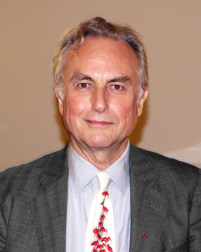
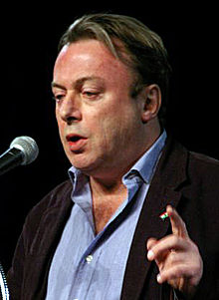
The “Four Horsemen of the Non-Apocalypse”
Richard Dawkins: English ethnologist, evolutionary biologist, known for his gene-centered view of evolution. (The Selfish Gene; The God Delusion; The Blind Watchmaker)
Christopher Hitchens: English
author, journalist, polemicist,
debater (died 12/11). (God is Not Great:
How Religion Poisons Everything;
The Portable Atheist: Essential Readings
for the Non-Believer)

Slide 7
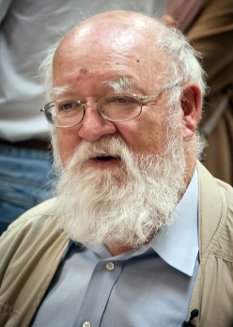
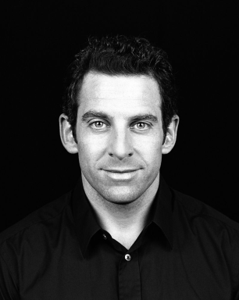
The “Four Horsemen of the Non-Apocalypse”
Daniel Dennett: American philosopher, cognitive scientist, evolutionary biologist. (Breaking the Spell: Religion as a Natural Phenomenon; Darwin’s Dangerous Idea)
Sam Harris: American author,
philosopher, neuroscientist.
(The End of Faith; Letter to a
Christian Nation; The Moral
Landscape)

Slide 8
Responding to the New Atheists
Why we believe God exists. (arguments for His existence)
Why we believe naturalism is insufficient to explain everything we observe in the universe (fine-tuning, morality, human intangibles like honor, love, trust, creativity – which mark us as being made in God’s image…)
Why we believe the Christian faith (and theism in general) is rational and logical.
Why we believe that theism (and Christianity especially) has been responsible for much of the good in human history, and that religion is not the cause of most wars and suffering.
Why we believe in the reliability of Scripture, the truth of miracles and the resurrection.
Why we believe and insist that religious belief is not going away; why it is, in fact, “properly basic” to human existence.

