Slide 1
OT Wisdom Literature (OT6)
The Book of Psalms – Part 2
May 15, 2014
Ross Arnold, Spring 2014 Lakeside institute of Theology

Slide 2
OT Wisdom Literature (OT6)
Apr 3 – Introduction to Wisdom Literature
Apr 10 – The Book of Job
Apr 17 – No Class (Holy Week)
Apr 24 – The Book of Psalms, Part 1
May 1 – No Class
May 8 – No Class
May 15 – The Book of Psalms, Part 2
May 22 – The Book of Proverbs
May 29 – The Book of Ecclesiastes
June 5 – The Song of Songs; Final Exam

Slide 3
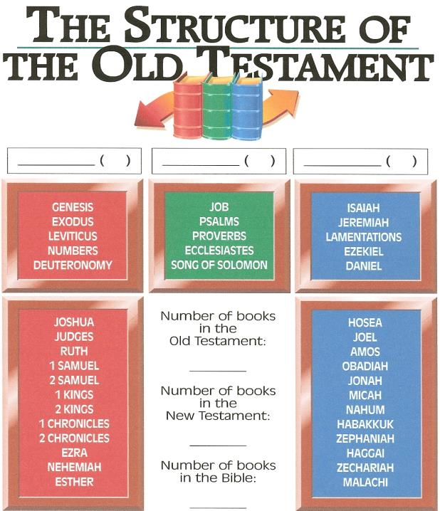
Law/History 5+12
Wisdom 5 Prophets 5+12
39
27
66

Slide 4
The Book of Psalms
Title: The Hebrew name for the book is Tehillim, or “Praises.” The Greek translation, psalmoi, means “instrumental music.”
Author: Seventy-three of the Psalms have superscriptions identifying King David as their author. Two (Ps. 72 & 127) are attributed to Solomon; Ps. 90 identifies Moses as its author; twelve Psalms (50, and 73-83) are ascribed to the family of Asaph; eleven Psalms (42, 44-49, 84-85, 87-88) are credited to the Sons of Korah; Ps. 88 is attributed to Heman; and Ps. 89 is assigned to Ethan the Ezrahite. Fifty Psalms do not identify their authors.
Date of Writing: If Moses did write Psalm 90 it would be the earliest, around 1450 BC; while Psalm 137 was apparently written during the Babylonian Captivity, around 586-538 BC. They were probably brought together into their present form shortly after the Captivity – around 537 BC.

Slide 5
The Book of Psalms
Recipients: The ancient Jewish people, and everyone since.
Themes: The Book of Psalms is the longest book in the Bible, with 150 “chapters” or individual psalms. It is also one of the most diverse, dealing with subjects such as God and his creation, war, worship, wisdom, sin and evil, judgment, justice, and the coming of the Messiah.
Content: The Book of Psalms is a collection of prayers, poems and hymns that served as the worship hymnal from ancient Israel, leading worshipers into praise and adoration of God.
Structure: The Book of Psalms is a divided into Five Sections, each closing with a doxology:
Book 1 – Psalm 1-41
Book 2 – Psalm 42-72
Book 3 – Psalm 73-89
Book 4 – Psalm 90-106
Book 5 – Psalm 107-150

Slide 6
The Book of Psalms
Types of Psalms: The simplest view of the Psalms identifies TWO forms – Psalms of Praise; and Psalms of Lament. But others have proposed the following Psalm forms:
Hymns – songs of praise for God and his work in creation.
Communal Laments – in which the nation laments some common disaster.
Royal Psalms – dealing with the king and events in his life.
Individual Laments – lamenting events in the life of an individual.
Individual Thanksgiving Psalms – in which an individual gives thanks for blessings.
Wisdom Psalms – similar to Proverbs.
Psalms of Remembrance – recollecting past events, especially God’s great work on behalf of the Israelites.
Judgment Psalms – visiting curses on enemies.

Slide 7
Hebrew Poetic Form
Hebrew Parallelism: A poetic form in which two or three parallel phrases are used to give variations on a them, to emphasize a point.
Synonymous Parallelism – in which the content of a first phrase is repeated in different words for emphasis.
Psalm 1:1: Blessed is the man who does not walk in the counsel of the wicked
or stand in the way of sinners
or sit in the seat of mockers.
Antithetic Parallelism: in which the content of a second phrase is contrasted sharply with the first phrase.
Psalm 1:6 For the Lord watches over the way of the righteous,
but the way of the wicked will perish.

Slide 8
Hebrew Poetic Form
Hebrew Parallelism: A poetic form in which two or three parallel phrases are used to give variations on a them, to emphasize a point.
Synthetic Parallelism – in which the content of a second phrase takes the thought of the first phrase further.
Psalm 1:2 But his delight is in the law of the Lord,
and on his law he meditates day and night.
Alphabetical Acrostics: in which the poets constructs line segments based on letters of the Hebrew alphabet.
Line segment acrostics – on which each line segment is linked to a letter. (Psalm 111-112)
Single line acrostics (Psalms 25, 34, 145)
Two line acrostics (Psalm 37)
Eight line acrostics (Psalm 119)

Slide 9
Progressive Theme Development
Psalm 22. The Suffering Servant
Psalm 23. The Good Shepherd
Psalm 24. The Sovereign King

Slide 10
Repeated Refrains
Hope in God, for I shall again praise Him
For the help of His presence (Psalm 42:5).
Hope in God, for I shall yet praise Him,
The help of my countenance and my God. (Psalm 42:11).
Hope in God, for I shall again praise Him, The help of my countenance and my God. (Psalm 43:5).

Slide 11
Give thanks to the Lord, for he is good; his love endures forever.
² Let Israel say:
"His love endures forever."
³ Let the house of Aaron say:
"His love endures forever."
⁴ Let those who fear the Lord say:
"His love endures forever."
Psalm 118:1-4

