Slide 1
Old Testament Wisdom Literature (OT6)
*Thursdays, 10 AM- 12 Noon, April 3-May 29, 2014
*Required Text: Encountering the Old Testament: A Christian Survey, Bill T. Arnold & Brian E. Beyer- $400 pesos
Ross Arnold, Spring 2014 Lakeside institute of Theology

Slide 2
Policies and Requirements
Classes are free, but all students seeking a certificate or degree must purchase books (paper, not electronic), which will be made available by the Institute.
Students in certificate or degree tracks may miss no more than one class per course, without making arrangements with the teacher to make up missed work (at the discretion of the teacher).
Students in certificate or degree tracks will be required to take a pass/fail final exam in each course, based on study guidelines provided by the teacher.
Students in certificate or degree tracks must make a passing grade (based on "pass/fail") in each course in order to receive credit towards a certificate or degree.
Candidates for degrees (Master of Theology and Master of Theology & Ministry) must be approved by the Institute Director before final admission into a degree program.

Slide 3
Policies and Requirements for making up classes, or taking classes online (as of April 3, 2014):
All make-up classes must be completed before the beginning of the following term, unless you make special arrangements with the professor.
All classes made up online must be reported via email to rda@rossarnold.net, as follows:
Each class much be reported in a separate email as soon after completion as possible.
Each email must contain the following information:
Course title and/or code (NT4, OT3, TH2, etc.).
The date of the original lecture you missed.
The title of the lecture.
A clear statement that you watched all of the lecture video, reviewed the materials and completed the required readings.
Courses taken entirely online require prior approval, and apply only to audit or Certificate (not degree) requirements.

Slide 4
OT Wisdom Literature (OT6)
Apr 3 – Introduction to Wisdom Literature
Apr 10 – The Book of Job
Apr 17 – No Class (Holy Week)
Apr 24 – The Book of Psalms, Part 1
May 1 – The Book of Psalms, Part 2
May 8 – No Class
May 15 – The Book of Proverbs
May 22 – The Book of Ecclesiastes
May 29 – The Song of Songs; Final Exam

Slide 5
Structure & Form of the Old Testament
The Law (5) – “Torah” in Hebrew; Genesis, Exodus, Leviticus, Numbers, Deuteronomy.
Prophets (8) – “Nevi’im” in Hebrew Joshua, Judges, Samuel (1&2), Kings (1&2) (sometimes called the Former Prophets); and Isaiah, Jeremiah, Ezekiel, the Twelve (sometimes called the Latter Prophets).
Writings (11) – “Ketuvim” in Hebrew
Books of Truth (Psalms, Proverbs, Job); “Five Scrolls” (Song of Songs, Ruth, Lamentations, Ecclesiastes, Esther), and “other writings” (Daniel, Ezra-Nehemiah, Chronicles (1&2)).

Slide 6
Structure & Form of the Old Testament
Traditional Protestant Structure: – 39 Books in Four Sections:
The Law (5) – “Torah” in Hebrew; “Pentateuch” or “Five Books” in Greek
History (12) – Joshua thru Esther.
Wisdom (5) – Job thru Song of Songs.
Prophesy (17) – Isaiah thru Malachi, (sometimes broken up into Major Prophets: Isaiah thru Daniel, and Minor Prophets: Hosea thru Malachi)

Slide 7
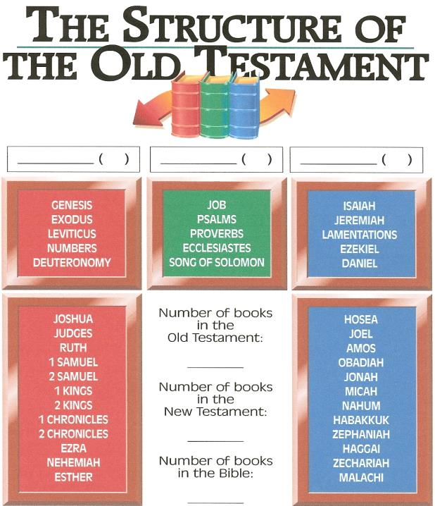
Law/History 5+12
Wisdom 5 Prophets 5+12
39
27
66

Slide 8
Definition of Wisdom Literature
In the Ancient Near East, “wisdom literature” was a genre characterized by practical answers to existential questions about God, humanity, Creation, evil and suffering.
The Hebrew Wisdom Literature of the Old Testament includes the books of Job, Proverbs and Ecclesiastes, to which are often added Song of Songs and (at least part of) the Psalms.
The Catholic Church adds the Apocryphal/ deuterocanonical books of Ecclesiasticus and Sirach, also called The Wisdom of Solomon.
New Testament “wisdom” writings include the parables of Jesus and the Book of James.

Slide 9
Understanding Wisdom Literature
Every culture devotes itself to gathering and preserving “experiential” knowledge – what has been learned about life & how best to live it – to pass on to others, especially the children.
OT Wisdom Literature reflects the ancient Israelite effort to capture this experiential knowledge.
The Wisdom Literature of the Old Testament might be called “God’s word written in human experience” – a very practical collection of knowledge gained from General Revelation, through observation of nature and human reason.
Wisdom writings are consistent with the Law of Moses, but recognize that the Law may not be directly applicable to all events in life – so wisdom is needed to interpret and apply the truth.

Slide 10
Hebrew Wisdom Literature
The Wisdom writings differ from the Books of the Law and the Prophets in that they draw on practical human experience of living in the world, rather than on “thus saith the Lord” kinds of revelation.
However, God’s presence & revelation are not dismissed by the Wisdom writing; rather they are assumed. Wisdom writings are fully consistent with Jewish theistic & ethical creeds.
The Hebrew Wisdom Literature deals with general ethical and religious topics – the concrete issues of life – without any effort at a philosophical system. (“How do you live” rather than “What is the meaning of life.” )

Slide 11
Hebrew Wisdom Literature
The ancient Hebrews were a practical, rather than philosophical, people – which is why we find no developed philosophy per se in the Old Testament. The most perfect knowledge is not the product of rational analysis, but of God’s divine revelation followed by real life application.
That is why Hebrew Wisdom literature sees the existence of Jewish law and custom, given by God, as the basis for right conduct – not the Greek philosophical arguments that good behavior is demanded for the health of the state and family, or out of fear of reprisal. (Some Wisdom writings – like Ecclesiastes – do say that punishment can follow poor choices, but good behavior is still primarily a response to God’s instructions.)

Slide 12
Hebrew Wisdom Literature
The Wisdom writings reflect a distinct approach to life – a way of living out a commitment to God in very deliberate, practical and rational ways.
Whereas most of the History & Prophetic books deal with major events during which God speaks through prophets and priests, the Wisdom literature reflects the time in-between these great events, helping to guide the people through the daily routines of life and its challenges – how to discipline an unruly child, how to teach children what they need to know to become worthy adults, the dangers of gossip and slander, the need for hard work, the dangers of wealth, why wicked people seem to prosper, the dangers of immoral behavior, why people suffer…

Slide 13
Hebrew Wisdom is Rooted in Reverence for God
God is the Creator both of people and the physical world, and all wisdom begins with that understanding.
God has ordained that all of creation reflects the goodness, nature and purpose of the Creator, so that we learn of God and his purposes by right (wise) perception of creation. (The basis for General Revelation.)
Wisdom accepts that the created world is good; there is no evidence in God’s creation of the evil material world of Greek thought.
Our responsibilities include finding God’s truth and purpose in his created world, and learning to live within the harmony of that divinely created order. This is “wisdom.”

Slide 14
Wisdom Does Not Appeal to Special Revelation
There tends to be no grounding in prophetic or priestly authority in wisdom thinking. Instead, the truth that is needed has already been given in God’s creation and our human experiences, interpreted by wisdom.
Tradition represents the wisdom of experience; preference is usually given to age and established ways of doing things.
Wisdom tends to be grounded in traditional social structures – the family, king, royal court, “schools” of wise elders.
Wisdom perspectives do not demand or expect radical change, but emphasize instead choosing the right path that will eventually lead to well being.

Slide 15
Wisdom’s Concern is Everyday Life & How to Live It Well
Wisdom is concerned with issues that face all of humanity, rather than with the unique events in history in which God has revealed himself.
Wisdom literature is little concerned with history, politics, God’s acts, miracles, sin, forgiveness or guilt. Not that these things are discounted, but wisdom is concerned with mundane aspects of life – raising children, providing economic security, finding an appropriate spouse, etc.
Wisdom’s focus is not mythical or spiritual, but is concerned with practical stability and order – how to live well with God, others and the world.
Wisdom’s truths are not unique to Israel, but are true for all people (though there is an assumption of Israel’s unique relationship with God).

