Slide 1
Letters of Paul (NT5)
*Thursdays, 1-3 PM, Jan.23-Mar.6, 2014
*Required Text: Encountering the New Testament, Walter Elwell & Robert Yarbrough- $400 pesos
Letters of 1 & 2 Corinthians
January 30, 2014
Ross Arnold, Winter 2014 Lakeside institute of Theology

Slide 2
Letters of Paul (NT5)
Life & Teachings of Paul; Romans
1st & 2nd Corinthians
Galatians & Ephesians
Philippians, Colossians & Philemon
1st & 2nd Thessalonians
Pastoral Epistles: 1st & 2nd Timothy, Titus
The Significance of Paul; Final Exam

Slide 3
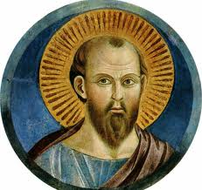
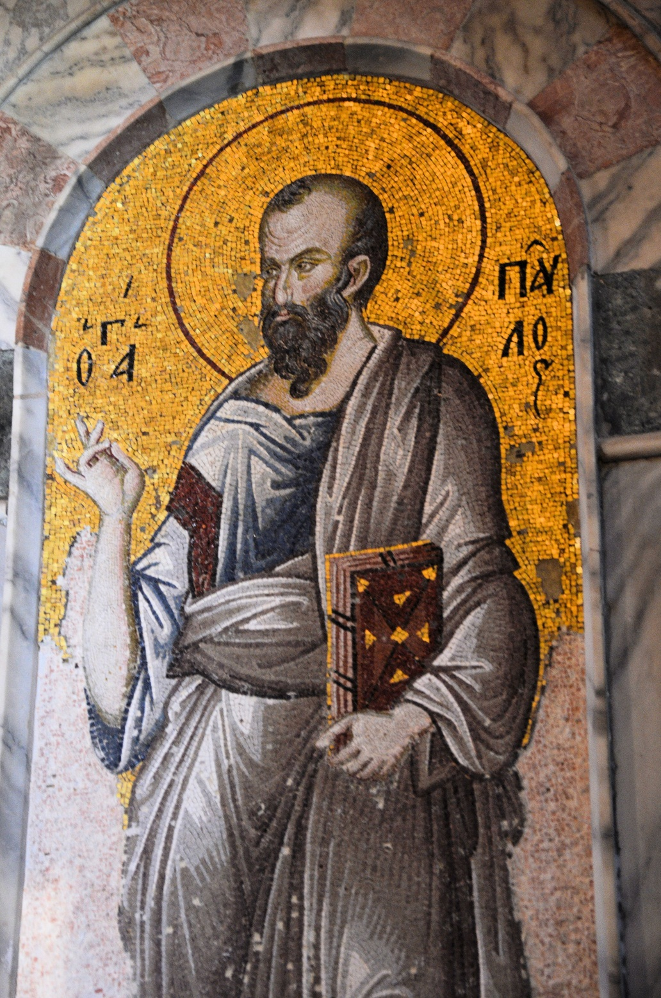
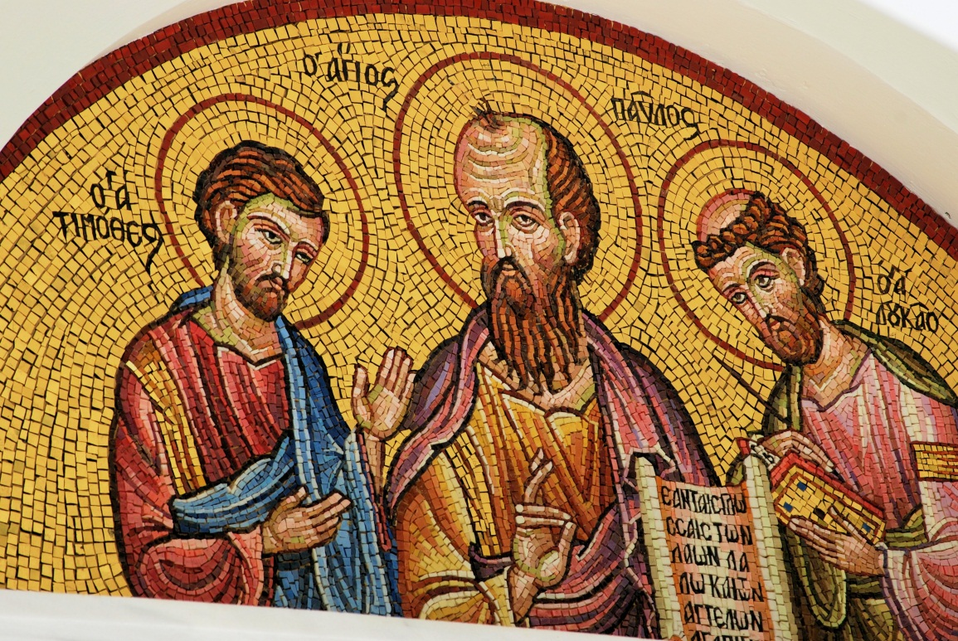

Slide 4
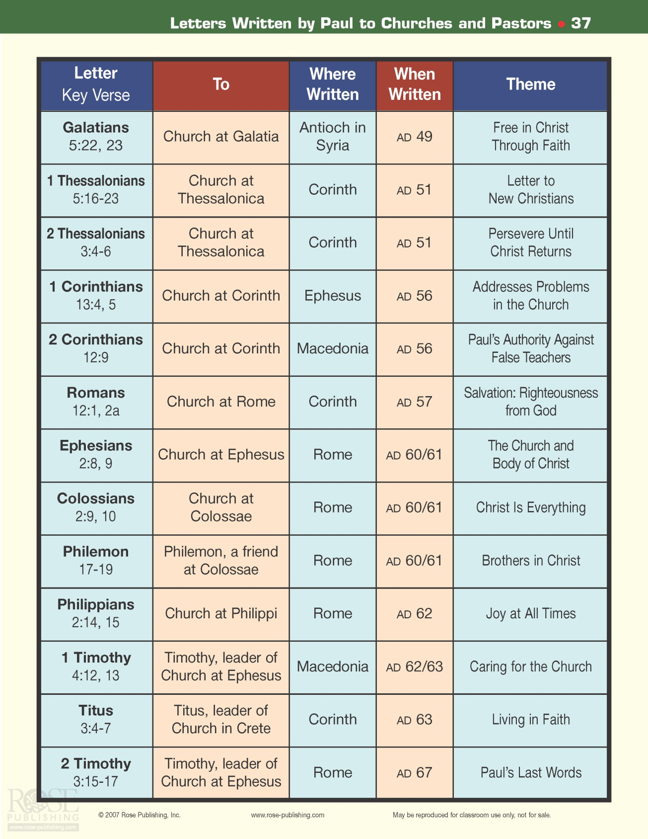

Slide 5
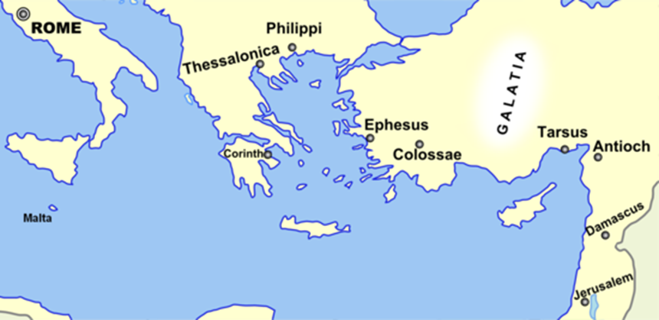

Slide 6
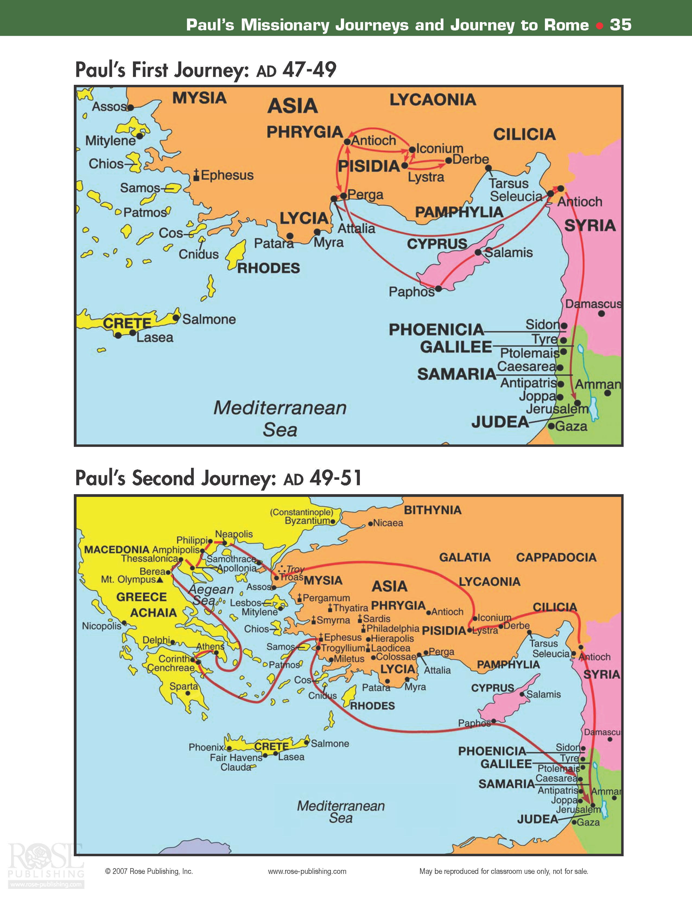

Slide 7
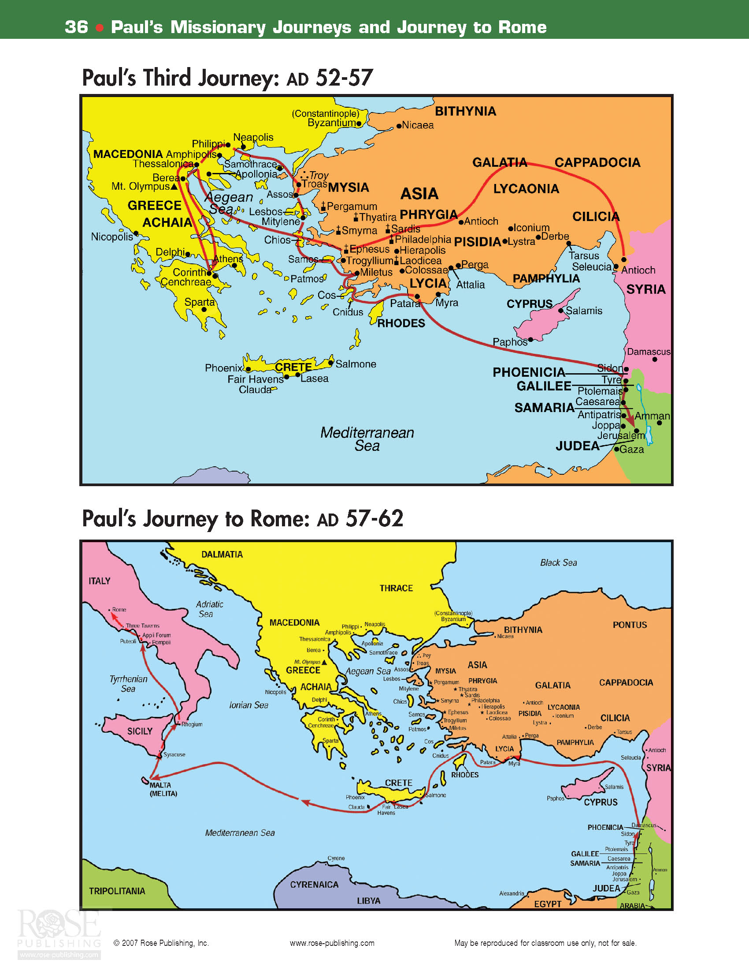

Slide 8
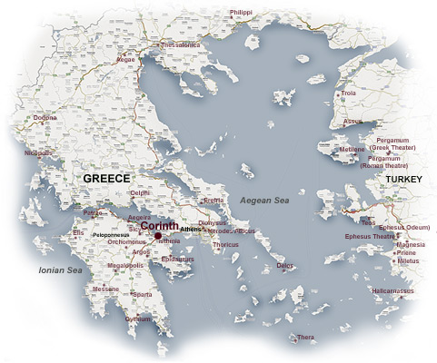

Slide 9
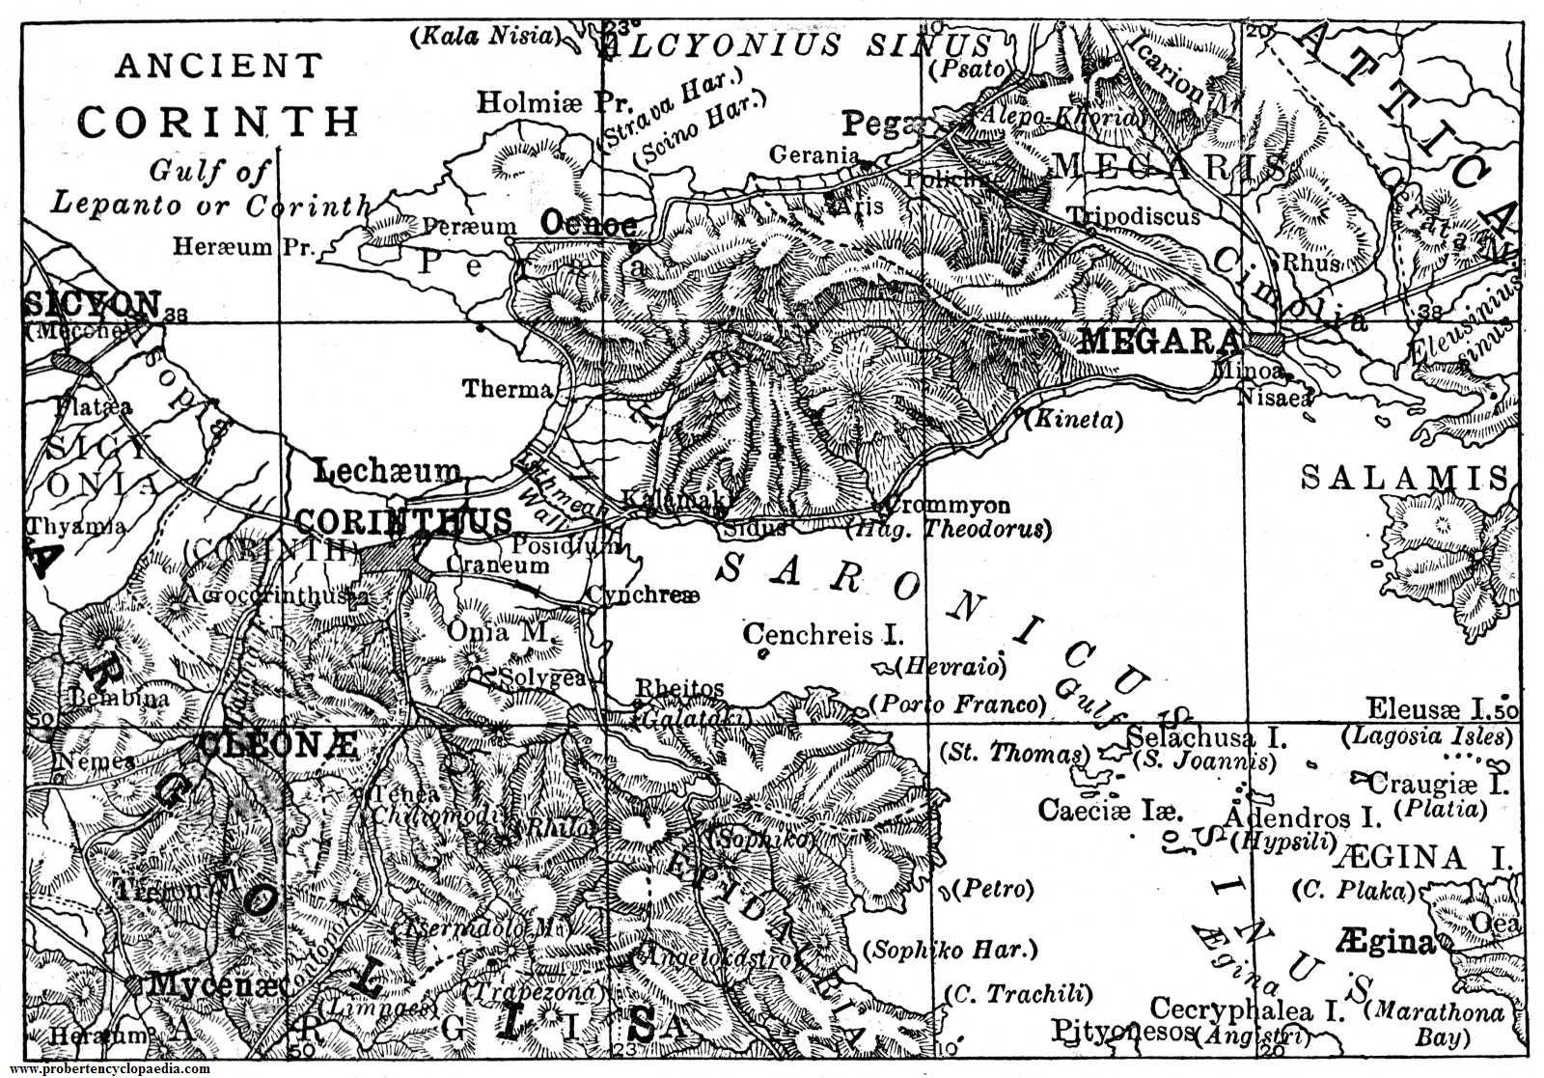

Slide 10
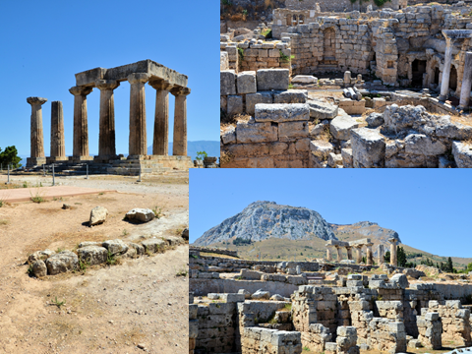

Slide 11
The Book of 1 Corinthians
Author: Apostle Paul
Date: c. AD 55-57
Theme: Problems in Christian conduct in the Corinthian church, including immaturity, divisions, jealousy, immorality and false teaching.
Purpose: To promote greater maturity in the church in one of Greece’s major cities.
Outline:*Answer to Report of Divisions (1-4)
*Answer to Report of Fornication (5-6)
*Answer to Letter of Questions (7-16)

Slide 12
Outline of 1 Corinthians
Introduction (1:1-9)
Division in the church (1:10-4:21)
The fact of the division (1:10-17)
The cause of the division (1:18-4:13)
A wrong conception of the Christian message (1:18-3:4)
A wrong conception of Christian ministry & ministers (3:5-4:5)
A wrong conception of Paul’s ministry(4:6-13)
Exhortation to end the divisions (4:14-21)
Morale & ethical disorders in the church (chs.5-6)
Laxity in church discipline (ch.5)
Lawsuits before non-Christian judges (6:1-11)
Warning against sexual immorality (6:12-20)
Instruction on marriage (ch.7)
General principles (7:1-7)
The problems of the married (7:8-24)
The problems of the unmarried (7:25-40)

Slide 13
Outline of 1 Corinthians (cont.)
V. Instruction on questionable practices (re: idols) (8:1-11:1)
The principles involved (ch.8)
The principles illustrated (ch.9)
A warning from the history of Israel (10:1-2)
The principles applied (10:23-11:1)
VI. Instruction on public worship (11:2-14:40)
Propriety in worship (11:2-16)
The Lord’s Supper (11:17-34)
Spiritual gifts (chs.12-14)
The test of the gifts (12:1-3)
The unity of the gifts (12:4-11)
The diversity of the gifts (12:13-31a)
The necessity of exercising the gifts in love (12:31b-13:13)
The superiority of prophesy over tongues (14:1-25)
Rules governing public worship (14:26-40)
VII. Instruction on the resurrection (ch.15)
The certainty of the resurrection (15:1-34)
Consideration of certain objections (15:35-57)
Concluding appeal (15:58)
VIII. Conclusion: Practical and personal matters (ch.16)

Slide 14
The Book of 2 Corinthians
Author: Apostle Paul
Date: c. AD 55-57
Theme: Paul’s defense and explanation of his apostleship.
Purpose: For Paul to defend his ministry and message, oppose false teachers, and admonish the Corinthians to clean up their act and to give (as promised) to the poor church in Jerusalem.
Outline: *Paul’s Explanation of His Ministry (1-7)
*Paul’s Collection for the Saints (8-9)
*Paul’s Vindication of His Apostleship (10-13)

Slide 15
Outline of 2 Corinthians
Apologetic: Paul’s explanation of his conduct and apostolic ministry (chs.1-7)
Greetings (1:1-2)
Thanksgiving for divine comfort in affliction (1:3-11)
Integrity of Paul’s motives and conduct (1:12-2:4)
Forgiving the offending parties at Corinth (2:5-11)
God’s direction in ministry (2:12-17)
The Corinthian believers – a letter from Christ (3:1-11)
Seeing the glory of God with unveiled faces (3:12-4:6)
Treasures in jars of clay (4:7-16a)
Prospect of death & what it means for the Christian (4:16b- 5:10)
The ministry of reconciliation (5:11-6:10)
A spiritual father’s appeal to his children (6:11-7:4)
The meeting with Titus (7:6-16)

Slide 16
Outline of 2 Corinthians (cont.)
II. Encouragement re: the collection for Christians in Jerusalem (chs.8-9)
Generosity encouraged (8:1-15)
Titus & his companions sent to Corinth (8:16-9:5)
Results of generous giving (9:6-15)
III. Paul’s vindication of his apostolic authority (chs.10-13)
Paul’s defense of his apostolic authority & the area of his mission (ch.10)
Paul forced into “foolish” boasting (chs.11-12)
Final warnings (13:1-10)
Conclusion, final greetings and benediction (13:11-14)

Slide 17
The Book of 2 Corinthians Key Verses
For we do not preach ourselves, but Jesus Christ as Lord, and ourselves as your servants for Jesus' sake. ⁶ For God, who said, "Let light shine out of darkness," made his light shine in our hearts to give us the light of the knowledge of the glory of God in the face of Christ. 2 Cor. 4:5-6
Therefore, if anyone is in Christ, he is a new creation; the old has gone, the new has come! ¹⁸ All this is from God, who reconciled us to himself through Christ and gave us the ministry of reconciliation: ¹⁹ that God was reconciling the world to himself in Christ, not counting men's sins against them. And he has committed to us the message of reconciliation. 2 Cor. 5:17-20

Slide 20
The Book of Galatians
Author: Apostle Paul
Date: c. AD 49
Theme: Salvation is by grace alone, and the Old Testament Law is not only unnecessary, but harmful.
Purpose: To correct the false teaching of Judaizers who had misled the Galatian churches after Paul planted them.
Outline: *Gospel of Grace Defended (1-2)
*Gospel of Grace Explained (3-4)
*Gospel of Grace Applied (5-6)

Slide 21
The Book of Galatians Key Verses
I have been crucified with Christ and I no longer live, but Christ lives in me. The life I live in the body, I live by faith in the Son of God, who loved me and gave himself for me. ²¹ I do not set aside the grace of God, for if righteousness could be gained through the law, Christ died for nothing!
Galatians 2:20-21
It is for freedom that Christ has set us free. Stand firm, then, and do not let yourselves be burdened again by a yoke of slavery.
Galatians 5:1

Slide 22
The Book of 1 Thessalonians
Author: Apostle Paul
Date: c. AD 51-52
Theme: Primarily an emphasis on the Second Coming of Christ.
Purpose: To provide instruction, support and encouragement to a young church in time of persecution.
Outline: *Personal Reflections on Thessalonians (1-3)
*Instructions for the Thessalonians (4-5)

Slide 23
The Book of 1 Thessalonians Key Verses
May the Lord make your love increase and overflow for each other and for everyone else, just as ours does for you. ¹³ May he strengthen your hearts so that you will be blameless and holy in the presence of our God and Father when our Lord Jesus comes with all his holy ones.
1 Thessalonians 3:12-13
For the Lord himself will come down from heaven, with a loud command, with the voice of the archangel and with the trumpet call of God, and the dead in Christ will rise first. ¹⁷ After that, we who are still alive and are left will be caught up together with them in the clouds to meet the Lord in the air. And so we will be with the Lord forever. ¹⁸ Therefore encourage each other with these words.
1 Thessalonians 4:16-18

Slide 24
The Book of 2 Thessalonians
Author: Apostle Paul
Date: c. AD 51-52
Theme: Presents an extensive eschatology.
Purpose: Similar to 1 Thess. – encourage persecuted believers, exhort to be steadfast and work, correct misunderstandings on Lord’s return.
Outline:*Encouragement in Persecution (1)
*Explanation of the Day of the Lord (2)
*Exhortation to the Church (3)

Slide 25
The Book of 2 Thessalonians Key Verses
Concerning the coming of our Lord Jesus Christ and our being gathered to him, we ask you, brothers, ² not to become easily unsettled or alarmed by some prophecy, report or letter supposed to have come from us, saying that the day of the Lord has already come. ³ Don't let anyone deceive you in any way, for that day will not come until the rebellion occurs and the man of lawlessness is revealed, the man doomed to destruction.
2 Thessalonians 2:1-3
…from the beginning God chose you to be saved through the sanctifying work of the Spirit and through belief in the truth. ¹⁴ He called you to this through our gospel, that you might share in the glory of our Lord Jesus Christ. ¹⁵ So then, brothers, stand firm and hold to the teachings we passed on to you, whether by word of mouth or by letter.
2 Thessalonians 2:13-15

