Slide 1
The Prophets
July 3, 2013 – Intro Lecture
Lakeside Institute of Theology
Ross Arnold, Summer 2013

Slide 2
Policies and Requirements
Classes are free, but all students seeking a certificate or degree must purchase books (paper, not electronic), which will be made available by the Institute.
Students in certificate or degree tracks may miss no more than one class per course, without arrangements made in advance with the teacher to make up missed work (at the discretion of the teacher).
Students in certificate or degree tracks will be required to take a pass/fail final exam in each course, based on study guidelines provided by the teacher.
Students in certificate or degree tracks must make a passing grade (based on "pass/fail") in each course in order to receive credit towards a certificate or degree.
Candidates for degrees (Master of Theology and Master of Theology & Ministry) must be approved by the Institute Director before final admission into a degree program.

Slide 3
Prophets (OT4)
Introduction – the Place of the Prophets
Major Prophets and Isaiah
Jeremiah and Lamentations
Ezekiel and Daniel
Book of the Twelve (Minor Prophets) – Hosea, Joel and Amos
Obadiah, Jonah, Micah, Nahum, Habakkuk and Zephaniah
Post-Exilic Prophets – Haggai, Zechariah and Malachi
The Message of the Prophets; Final Exam

Slide 4
Why Study the Old Testament?
It is the “Scriptures” referred to by Jesus and the Apostles.
The Old Testament is part of God’s inspired revelation to us.
The Old Testament is foundational to our understanding.
The Old Testament is practical.
The Old Testament points to Jesus Christ.

Slide 5
Why Study the Old Testament?
Above all, you must understand that no prophecy of Scripture came about by the prophet’s own interpretation of things. ²¹ For prophecy never had its origin in the human will, but prophets, though human, spoke from God as they were carried along by the Holy Spirit.
2 Peter 1:20-21

Slide 6
Structure & Form of the Old Testament
Traditional Jewish Structure: – 24 Books in Three Sections:
The Law (5) – “Torah” in Hebrew;
Prophets (8) – “Nevi’im” in Hebrew
Writings (11) – “Ketuvim” in Hebrew.
Together these sections form the acronymn TaNaKh, or Hebrew Bible. (also known as “Miqra” or “that which is read”)

Slide 7
Structure & Form of the Old Testament
Traditional Protestant Structure: – 39 Books in Four Sections:
The Law (5) – “Torah” in Hebrew; “Pentateuch” or “Five Books”
History (12) – Joshua thru Esther.
Wisdom (5) – Job thru Song of Songs.
Prophesy (17) – Isaiah thru Malachi, (sometimes broken up into Major Prophets: Isaiah thru Daniel, and Minor Prophets: Hosea thru Malachi)

Slide 8
Prophets and the Prophetic Role
Prophet: one who speaks for God and interprets His will to the people (which may or may not involve telling the future).
Moses was the first true prophet and the prototype for those to come.
The Lord said …. ¹⁸ I will raise up for them a prophet like you (Moses) from among their brothers; I will put my words in his mouth, and he will tell them everything I command him. Deut. 18:17f
Samuel has been called “the last of the Judges and the first of the prophets,” (Acts 3:24; 13:20) though there were prophets before Samuel.

Slide 9
Prophets and the Prophetic Role
Those called prophets prior to Samuel
Enoch (Jude 14)
Abraham (Genesis 20:7)
Moses (Numbers 12:1-8; Deut. 34:10; Hosea 12:13)
Miriam (prophetess; Exodus 16:20)
Eldad, Medad and the Seventy (Numbers 11:24-29)
Deborah (prophetess; Judges 4:4)
Prophets during the Combined Monarchy
Samuel (1 Samuel 3:1)
Gad (2 Samuel 22:5)
Nathan (2 Samuel 12:1)
Ahijah (1 Kings 12:22)
Asaph, Heman, Jeduthun (1 Chronicles 25:1)
Iddo (2 Chronicles 9:29)

Slide 10
Prophets and the Prophetic Role
Prophets - Divided Monarchy to Assyrian Period (c. 931-800 BC)
Shemaiah (1 Kings 12:22)
Ahijah, Iddo, Hanani (2 Chronicles 9:29; 16:7)
Jehu (1 Kings 16:1)
Elijah (1 Kings 17:1)
Elisha (1 Kings 19:16)
Micaiah (1 Kings 22:4)
Jehaziel & Eliezer (2 Chronicles 20:14, 37)
Zechariah (2 Chronicles 24:19)
“Unnamed prophets” (1 Kings 20:13; 2 Kings 9:4)

Slide 11
Highlights of Jewish History
c. 2090 BC – Abram is called by God and becomes Father to the Hebrew people.
c. 1445-1405 BC – Exodus from Egypt; God gives the Law thru Moses; 40 years in desert; entry into Promised Land.
1050 BC – United Monarchy (Saul, David, Solomon)
931 Kingdom Divided – Southern Kingdom of Judah; Northern Kingdom of Israel.

Slide 12
Highlights of Jewish History
Neo-Assyrian Empire – 934-609 BC
722 BC – Destroys Northern Kingdom of Israel
721 BC – Miracle prevents destruction of Judah under King Hezekiah (2 Kings 18; 2 Chron. 32)
612 BC – Assyria conquered by Babylonians
Neo-Babylonian Empire – 626-539 BC
599 BC – Babylonians conquest of Judah; 1st Deportation (includes Prophet Ezekiel)
586 – Babylonians destroy Jerusalem; 2nd Deportation
586-538 BC – the Babylonian Exile.
582 BC – Third Deportation.

Slide 13
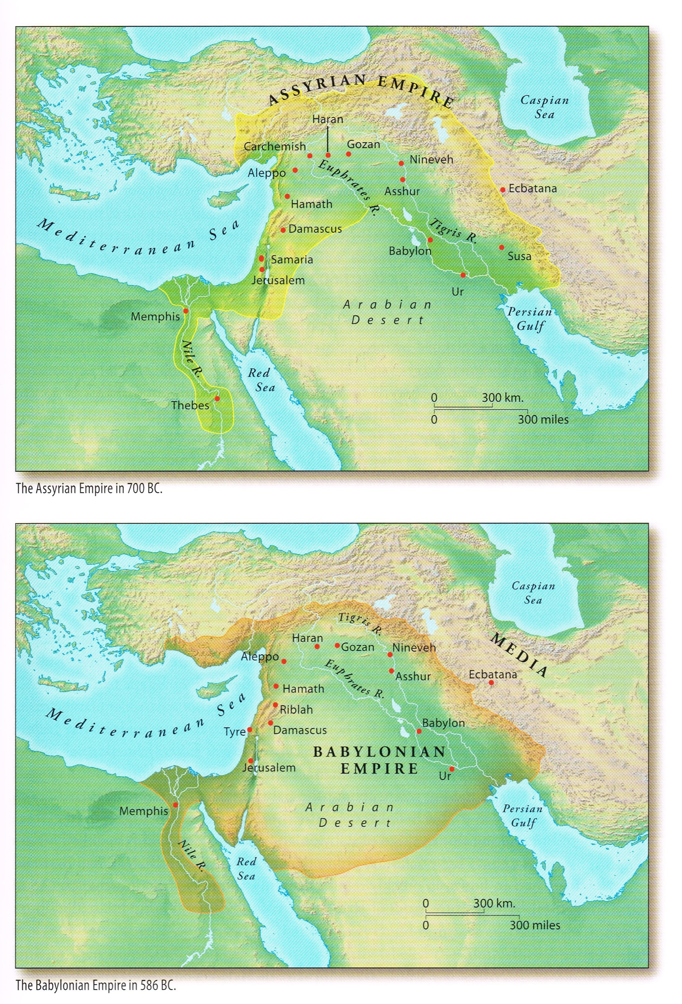

Slide 15
Highlights of Jewish History
Persian Period – 538-333 BC.
539 BC – Persia conquers Babylon
538 BC – King Cyrus allows 42,000 Jews to return under Zerubbabel and Joshua.
c. 450s BC – Ezra leads more returnees back, teaches & encourages Torah focus
c. later 400s –Nehemiah returns and rebuilds Jerusalem’s walls.
430 BC – Malachi, the last OT prophet.

Slide 16
Two Categories of Latter Prophets
Major Prophets
Isaiah (700s): Judah, pre-Exile (chs.1-39); Exile (40-55); post-Exile (56-66).
Jeremiah (627-587): Judah, pre-Exile.
Ezekiel (593-571): Judah, during Exile in Babylon.
Minor Prophets (the Book of the Twelve)
Hosea (767-752): Israel, pre-Exile, regarding unfaithfulness of Israel to God.
Joel (500s): Judah, post-Exile, judgment approaches, symbolized by locusts.
Amos (760s-750s): Israel, pre-Exile, against injustices in Northern Kingdom.
Obadiah (500s): (600s): Judah, during Exile, oracle against Edom.
Jonah (c. 786-746): unique short-story narrative of witness to Nineveh.
Micah (750-732): Judah, pre-Exile, both doom and hope for Judah.
Nahum (663-612): Judah, pre-Exile, rejoicing at the fall of Nineveh (Assyria).
Habakkuk (c. 606): Judah, pre-Exile, lament against Babylonian victories.
Zephaniah (630-625): Judah, pre-Exile, coming annihilation as judgment.
Haggai (520): Judah, post-Exile, regarding rebuilding the Temple.
Zechariah (520-518): Judah, post-Exile, regarding rebuilding the Temple.
Malachi (450-400): Judah, post-Exile, call to obedience and future purification.

Slide 17
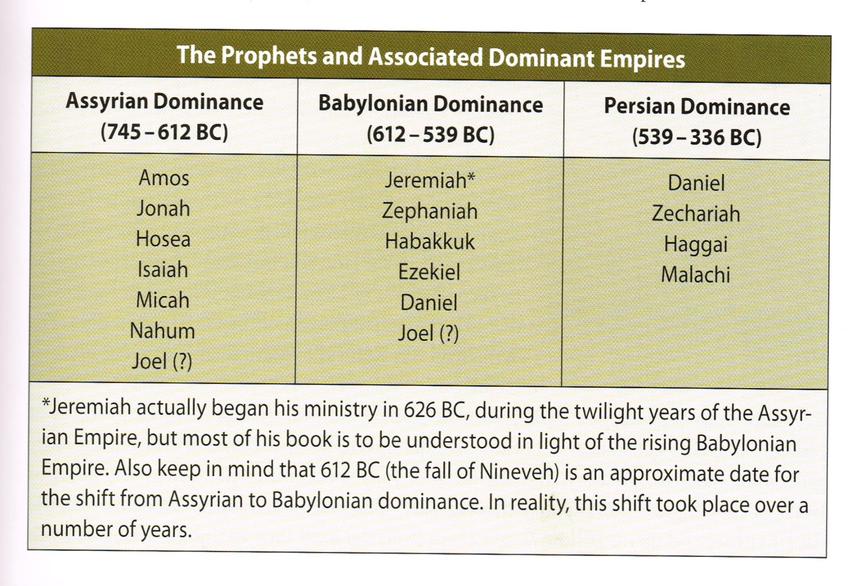

Slide 18
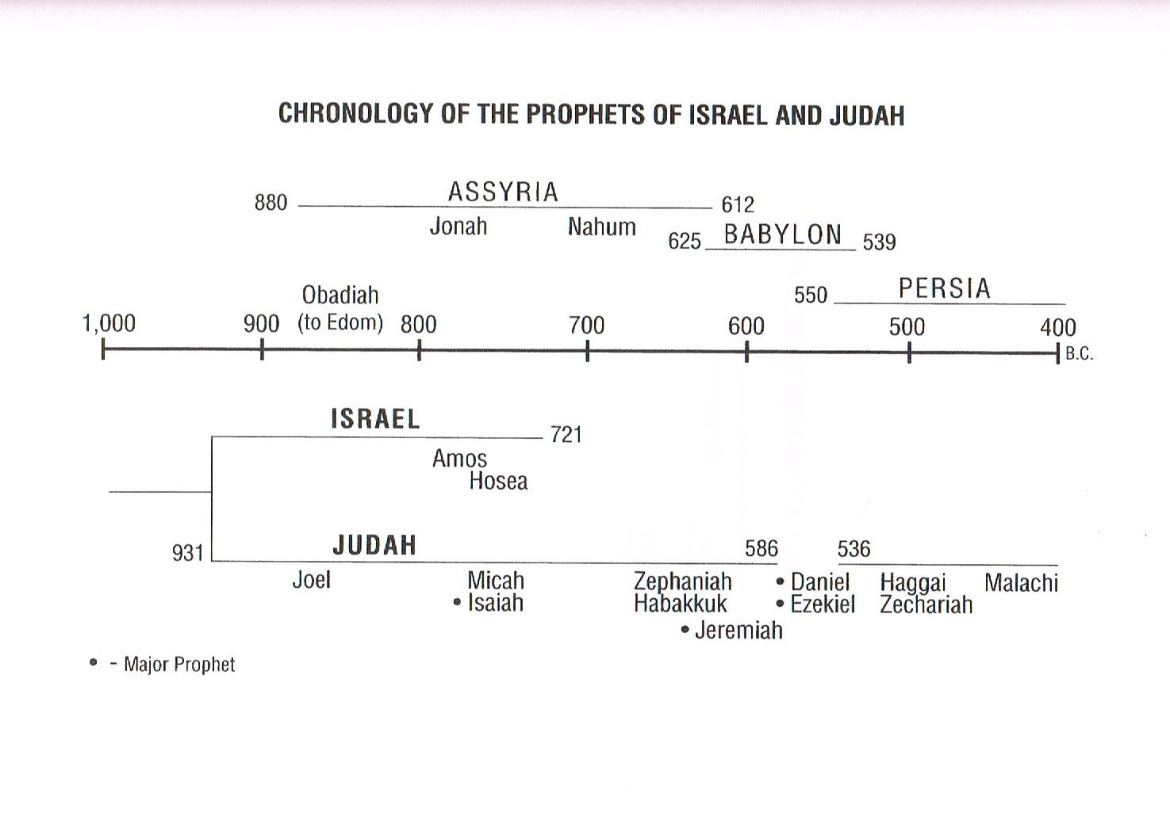

Slide 19
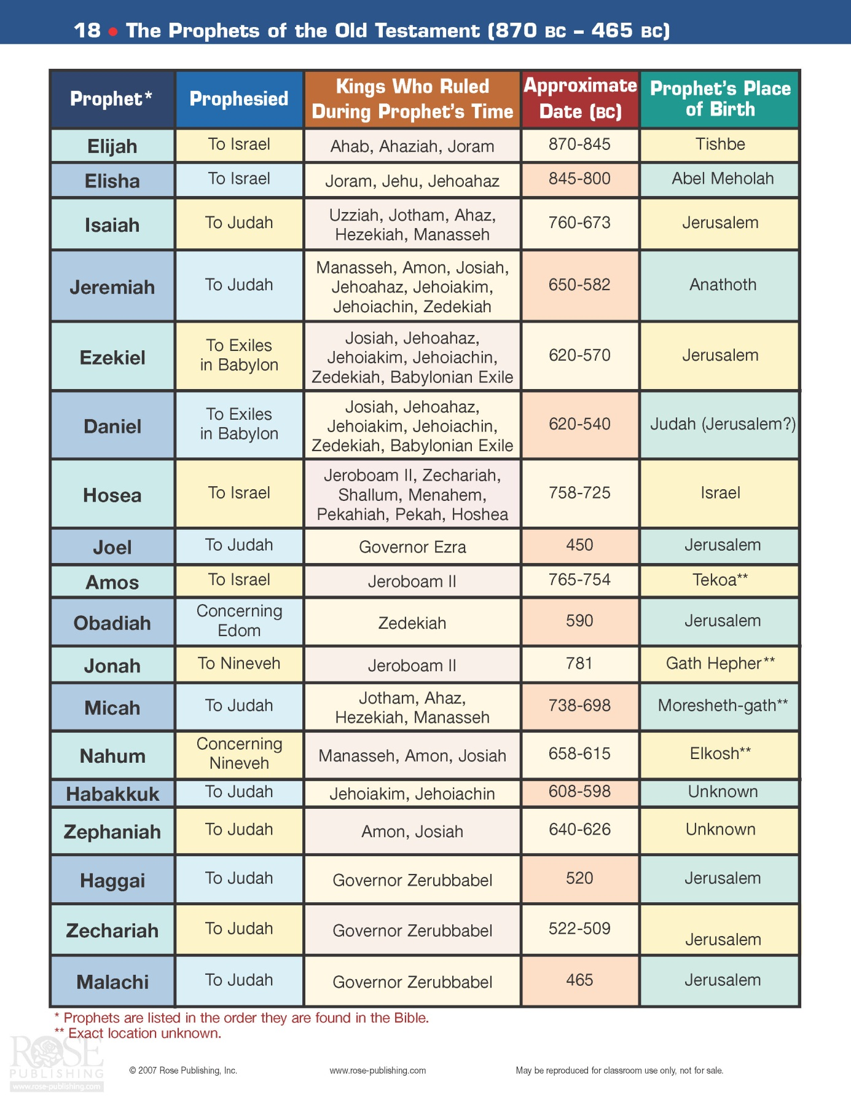
Major Oral Prophets
Major Literary Prophets
Minor Literary Prophets

Slide 20
The Message of the Prophets
The Old Testament prophetic books provide a crucial bridge for continuity between God’s message in the Old Testament and God’s message in the New Testament.
The Old Testament introduces TWO major story cycles, both of which are addressed in the prophetic books:
Genesis 3-11 presents the cosmic, worldwide story of sin and separation.
Genesis 12 to 2 Kings 25 is about God’s call and plan for Israel.
The Prophets declare that the specific theological story of Israel will merge with the cosmic universal theological story of Genesis 3-11 into one spectacular restoration that will bring Israel and the nations together under a glorious and righteous Davidic Messiah.

Slide 21
The Message of the Prophets
The message of the Old Testament prophets can be summarized in three basic points:
You (Israel/Judah) have broken the covenant; you had better repent!
No repentance? Then judgment! Judgment will also come on all nations.
Yet there is hope beyond the judgment, of a glorious future restoration for both Israel/Judah and for the nations.
The specific failings of the Hebrew people were especially idolatry, social injustice, and reliance on religious ritualism instead of true worship.

