Slide 1
Church History 2
Reformation to Today
July 19, 2013 – Other Reformers Lecture
Lakeside Institute of Theology
Ross Arnold, Summer 2013

Slide 2
Church History 2 (TH2)
Intro – Forces Leading to Reformation
Reformation Begins – Luther
Other Reformers – Zwingli, Anabaptists, Calvin, Knox
Growth of Protestantism
Catholicism & Counter-Reformation
Orthodoxy, Rationalism and Pietism
Beyond Christendom
Materialism & Modern Times; Final Exam

Slide 3
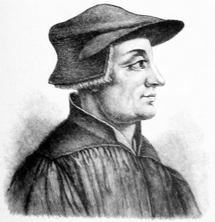
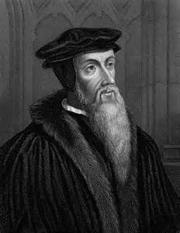
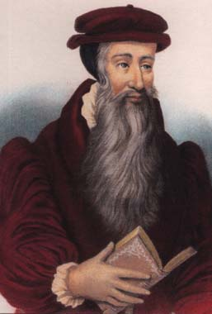
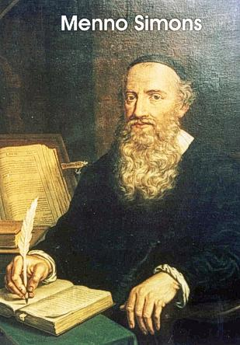
Ulrich Zwingli
1484-1531
John Calvin
1509-1564
John Knox 1514-1572
Menno Simons
1496-1561

Slide 4
Ulrich Zwingli
Lived 1484-1531; leader in 16th century Protestant Reformation movement in Switzerland.
1484 – Born in small Swiss village, 2 months after Martin Luther.
Studied at universities in Basel, Bern and Vienna.
1506 – Master of Arts degree; became priest in village of Glarus.
1512 & 1515 – Went with Swiss mercenaries on Italian campaigns.
1516 – Became abbey priest; preached against pilgrimages.
1518 – Became pastor of Grossmunster in Zurich; began to reach conclusions similar to Luther’s; preached for Church reform.
1519 – Plague kills ¼ of Zurich population; almost kills Zwingli. Bernhardin Sanson arrives to sell indulgences; is turned away. Zurich refuses to send mercenaries to support French.
1522 – Zwingli preaches against obligatory fasting during Lent; the Affair of the Sausages. Marries; preaches against celibacy.
1523 – Zwingli “debates” bishop’s legate; final break with Rome.
1524-31 – Swiss Reformation continues; clergy marry; communion in both kinds; icons removed; infant baptism challenged; etc.
1529 – Marburg Colloque: Luther, Zwingli, Melanchthon, Bucer, etc.
1531 – Zwingli is killed when 5 Catholic cantons attack Zurich.

Slide 5
John Calvin
Lived 1509-1564; chief systematic theologian of the Protestant Reformation; founder of Reformed theology and churches.
1509 – Born in Noyon, France.
1521 – Becomes bishop’s clerk at age 12.
1525 – Withdrawn from philosophy study to enter law school.
1532 – Licenced in law; publishes first book.
1533 – Experiences religious conversion; blamed for Cop address.
1536 – Published 1st (Latin) edition of Institutes. Decides to move to Strasbourg to study and write; stops over in Geneva; is convinced by William Farel to stay and help there.
1538 – Invited to pastor French refugees in Strasbourg (Bucer)
1541 – Returns to Geneva.
1553 – Michael Servetus condemned and executed in Geneva.
1559 – Opening of the Geneva Academy, under Theodore Beza.
1560 – Final edition of Institutes of the Christian Religion.
May 27, 1564 – John Calvin dies.

Slide 6
Ulrich Zwingli
1484-1531
John Calvin
1509-1564
John Knox 1514-1572
Menno Simons
1496-1561

