Slide 1
The Prophets
July 17, 2013 – Jeremiah & Lamentations
Lakeside Institute of Theology
Ross Arnold, Summer 2013

Slide 2
Prophets (OT4)
Introduction – the Place of the Prophets
Major Prophets and Isaiah
Jeremiah and Lamentations
Ezekiel and Daniel
Book of the Twelve (Minor Prophets) – Hosea, Joel and Amos
Obadiah, Jonah, Micah, Nahum, Habakkuk and Zephaniah
Post-Exilic Prophets – Haggai, Zechariah and Malachi
The Message of the Prophets; Final Exam

Slide 3
Daniel
Isaiah
Jeremiah
Ezekiel
TO WHOM
Jews in Judah/ Jerusalem
Jews in Judah & in Captivity
Jews Captive in Babylon
Jews in Babylon & Gentile Kings
ABOUT
Judah & Jerusalem (Isaiah 1:1,2:1)
Judah & Nations
(Jer. 1:5, 9-10; 2:1-1)
Whole House of Israel
(Ezek. 2:3-6; 3:4-10, 17)
Israel & Gentile Nations
(Daniel 2:36ff; 9)
DURING REIGNS OF:
Kings of Judah: Uzziah, Jotham, Ahaz, Hezekiah
Kings of Judah: Josiah, Jehoahaz Jehoiakim, Jehoiachin, Zedekiah
King of Judah: Zedekiah
King of Babylon: Nebuchadnezzar
Kings of Judah: Jehoiakim, Jehoiachin, Zedekiah
King of Babylon: Nebuchadnezzar
DATES
740-680 BC
627-585 BC
592-570 BC
605-536 BC
HISTORICAL SETTING
2 Kings 15-21;
2 Chron. 26-30
2 Kings 22-25
Daniel 1-6
Daniel 1-6

Slide 4
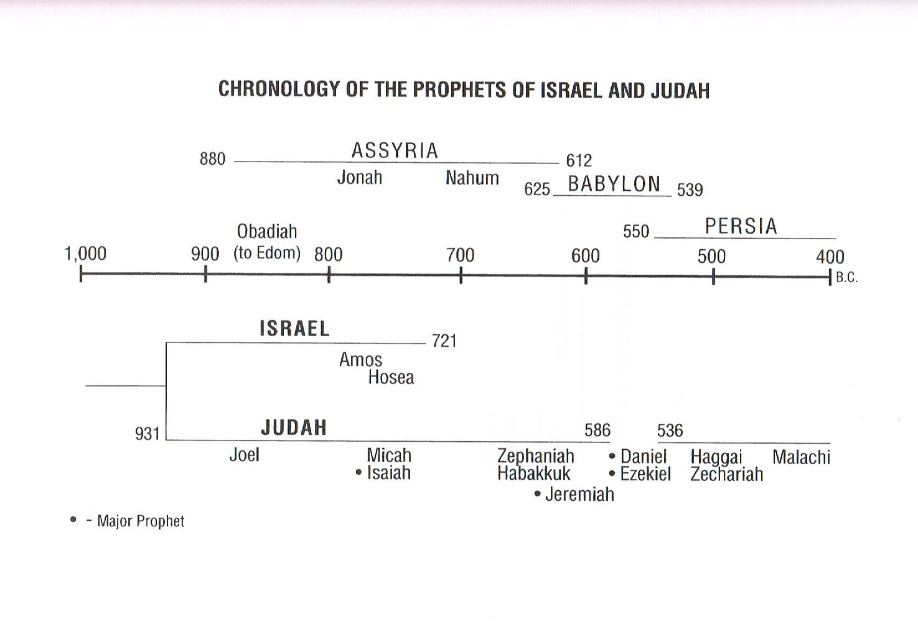

Slide 5
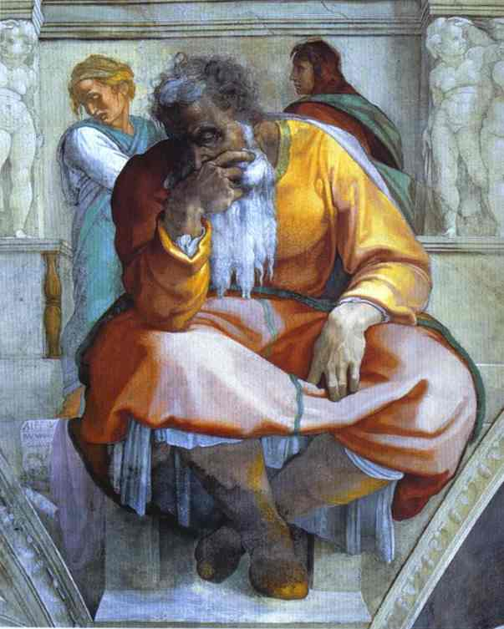
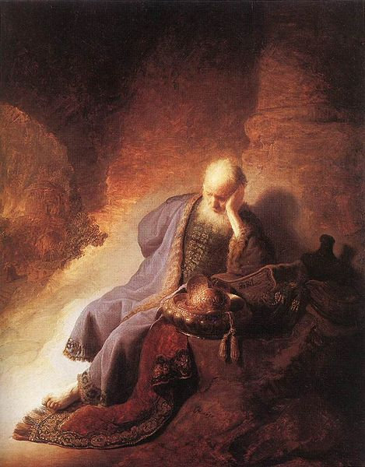

Slide 6
The Message of Jeremiah
Like Isaiah before him, Jeremiah emphasizes the 3-Point message of the Old Testament prophets:
You (Israel/Judah) have broken the covenant; you had better repent!
No repentance? Then judgment! Judgment will also come on all nations.
Yet there is hope beyond the judgment, of a glorious future restoration for both Israel/Judah and for the nations.
Also like Isaiah, Jeremiah points to the specific failings of the Hebrew people: idolatry, social injustice, and religious ritualism instead of true worship.

Slide 7
The Message of Jeremiah
Date of the Book: c. 585 BC
Theme and Purpose: The theme is Judgment Against Judah. The book identifies the sins, idolatry and covenant breaking by the people of the Kingdom of Judah, and the coming judgment at the hands of the Babylonian Empire.
Key Chapter: Chapter 31. Amid all the declarations given by God through Jeremiah of coming judgment and condemnation, the 31st chapter of the Book of Jeremiah promises a time of renewal when Yahweh will make a new covenant and write it on the hearts of all the people.

Slide 8
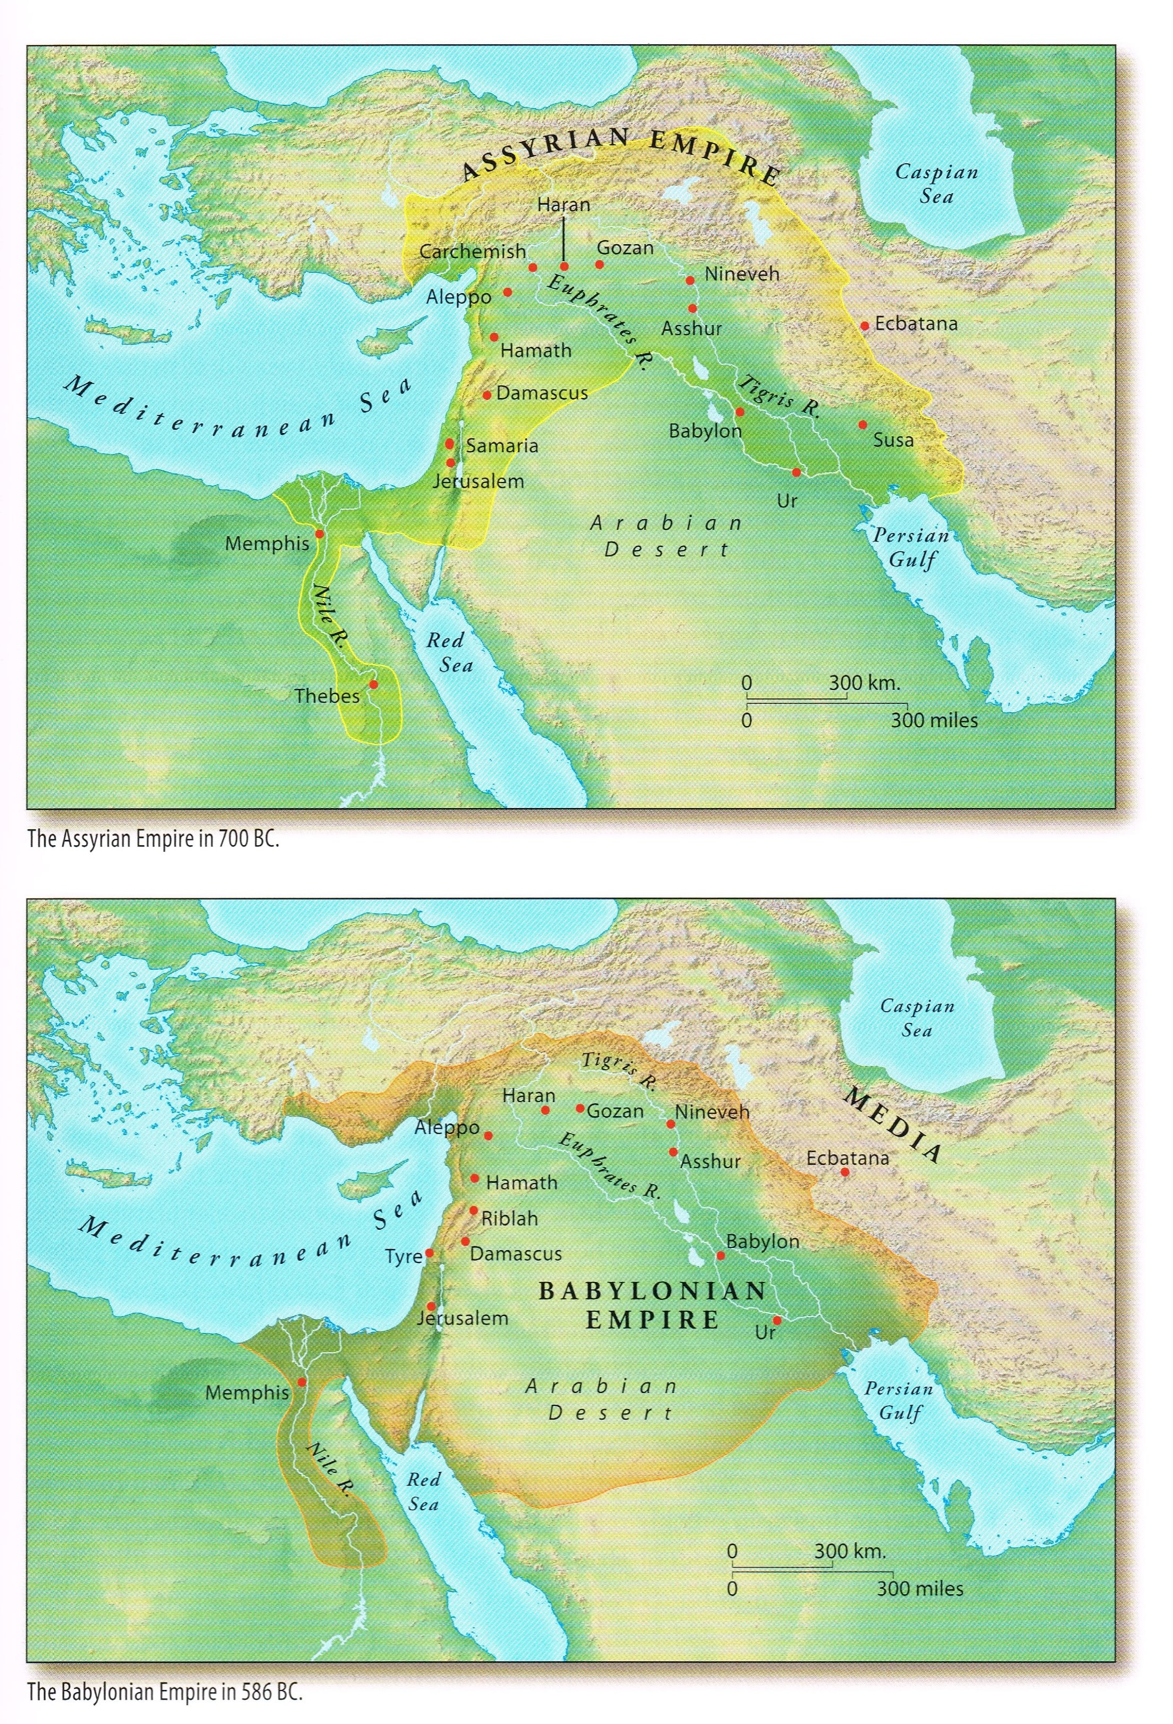

Slide 10
Key Verses in Jeremiah
For when I brought your ancestors out of Egypt and spoke to them, I did not just give them commands about burnt offerings and sacrifices, ²³ but I gave them this command: Obey me, and I will be your God and you will be my people. Walk in obedience to all I command you, that it may go well with you. ²⁴ But they did not listen or pay attention; instead, they followed the stubborn inclinations of their evil hearts. They went backward and not forward. Jeremiah 7:22-24
“Peace, peace,” they say, when there is no peace. ¹² Are they ashamed of their detestable conduct? No, they have no shame at all; they do not even know how to blush. So they will fall among the fallen; they will be brought down when they are punished, says the Lord.
Jeremiah 8:11-12

Slide 11
Key Verses in Jeremiah
“The days are coming,” declares the Lord, “when I will make a new covenant with the people of Israel and with the people of Judah. ³² It will not be like the covenant I made with their ancestors when I took them by the hand to lead them out of Egypt, because they broke my covenant, though I was a husband to them,” declares the Lord.
³³ “This is the covenant I will make with the people of Israel after that time,” declares the Lord. “I will put my law in their minds and write it on their hearts. I will be their God, and they will be my people.
³⁴ No longer will they teach their neighbor, or say to one another, ‘Know the Lord,’ because they will all know me, from the least of them to the greatest,” declares the Lord. “For I will forgive their wickedness and will remember their sins no more.” Jeremiah 31:31-34

Slide 12
The Message of Jeremiah
God calls Jeremiah to service (1:1-19)
Jeremiah describes Judah’s sin (2:1-10:25)
A failing marriage (2:1-3:5)
A story of two sisters (3:6-4:4)
Trouble from the North (4:5-6:30)
Worthless public worship (7:1-8:3)
Treachery, trouble and tears (8:4-10:25)
Jeremiah struggles with people & God (11:1-20:18)
Coping with conspiracies (11:1-12:17)
Three signs of judgment (13:1-27)
Judah’s desperate situation (14:1-17:27)
A lesson from the potter’s house (18:1-19:15)
Persecution leads to despair (20:1-18)

Slide 13
Jeremiah challenges rulers & prophets (21:1-29:32)
Jeremiah rebukes rulers & governments (21:1-23:8)
Jeremiah rebukes prophets & their audiences (23:9-40)
Jeremiah describes God’s anger (24:1-25:38)
Jeremiah confronts the people (26:1-24)
Jeremiah wears a yoke (27:1-28:17)
Jeremiah writes to the exiles (29:1-32)
The Book of Comfort (30:1-33:26)
Israel’s return to the land & to God (30:1-31:40)
Jeremiah’s symbolic land purchase (32:1-44)
God’s great future works (33:1-26)
The failure of Jerusalem’s leaders (34:1-39:18)
They do not keep their word (34:1-22)
They have not learned obedience (35:1-19)
They refuse to respect God’s Word (36:1-32)
They refuse to listen to God’s prophet (37:1-38:28)
Jerusalem pays a tragic price (39:1-18)

Slide 14
Jerusalem after its fall (40:1-45:5)
Trouble from within (40:1-41:18)
Trouble in Egypt (42:1-43:13)
Failure to learn from history (44:1-45:5)
Oracles about the nations (46:1-51:64)
Egypt (46:1-28)
Philistia (47:1-7)
Moab (48:1-47)
Ammon (49:1-6)
Edom (49:7-22)
Damascus (49:23-27)
Kedar & Hazor (49:28-33)
Elam (49:34-39)
Babylon (50:1-51:64)
Jerusalem’s fall revisited (52:1-34)

Slide 15
The Message of Lamentations
Jerusalem’s lament (1:1-22)
Jerusalem’s angry God (2:1-22)
Judah’s lament (3:1-66)
Judah’s utter ruin (4:1-22)
Judah’s plea (5:1-22)

