Slide 1
Church History 1
Apostles to Pre-Reformation
April 30, 2013 –
Emperors, Bishops, Saints & Intellectuals Lecture
Lakeside Institute of Theology
Ross Arnold, Spring 2013

Slide 2
Church History 1 (TH1)
Introduction to Church History
Apostles to Catholic Christianity
Persecution, Heresies & the Book
Emperors, Bishops, Saints & Intellectuals
Councils, Monks, Popes & Augustine
Schisms, Barbarians & Gregory the Great
Charlemagne, Cathedrals, Crusades & Scholastics
Poverty, Inquisition, Babylonian Captivity… & Final Exam

Slide 3
Persecutions
Officially sanctioned persecution affected the Church from its founding until the Emperor Constantine and the Edict of Milan made Christianity legal in the 4th Century.
1st Century Persecution
Persecution from Jewish religious authorities (Book of Acts)
Emperor Nero (64-68 AD)
Domitian (89-96 AD)
2nd Century Persecution
Hadrian (117-138 AD)
Trajan (98-117 AD) (& Pliny the Younger, Governor of Bithynia)
Marcus Aurelius (161-180 AD)
3rd-4th Century Persecution
Septimus Severus (193-211)
Caracalla (211-218)
Decius (249-251)
Valerian (253-259)
Diocletian/Galerius (284-305) (The Great Persecution)
Edict of Milan, religious freedom under Emperor Constantine (313 AD)

Slide 4
Persecutions
3rd-4th Century Persecution
Septimius Severus (193-211)
Decius (249-251)
Valerian (253-260)
Diocletian/Galerius (284-305) (The Great Persecution)
Edict of Milan (313 AD) brought religious freedom under Emperor Constantine (and Lucinius…)

Slide 5
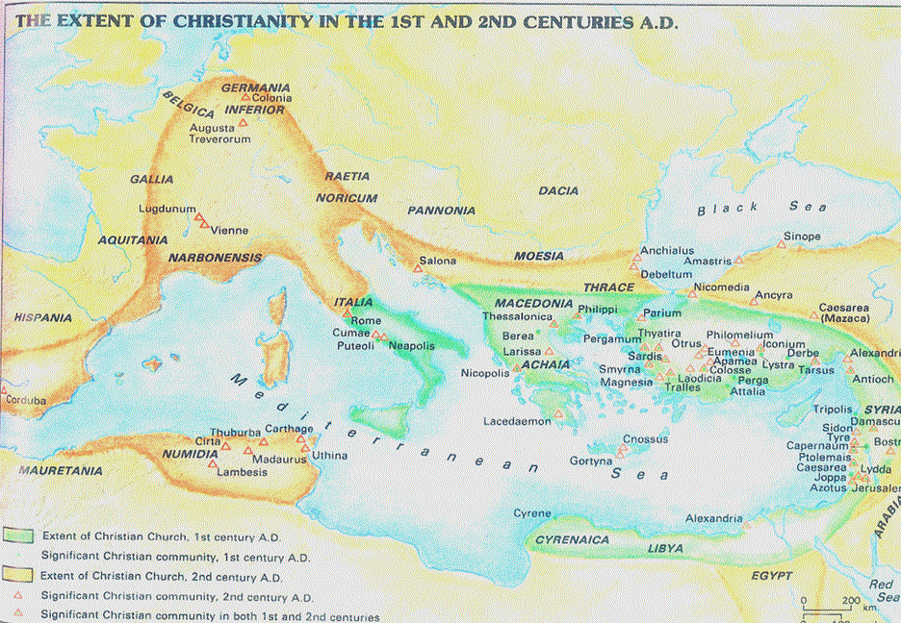
Growth of Christianity, 1st & 2nd Centuries

Slide 6
Decius and Valerian
Emperor Septimius Severus (193-211)
His Problems:
Severus had managed to put and end to a series of civil wars.
But border “barbarians” still were a constant threat.
And dissident groups within the empire threatened civil uprising.
His Solution:
Unite the empire religiously – syncretism under Sol Invictus.
So in 202 Severus forbade conversion to Judaism or Christianity.
Result: local persecutions, w/ focus on teachers & new converts.
Emperor Decius (249-251)
The Roman Empire still had serious problems
Barbarians still threatened the borders, with regular incursions.
There was a serious economic crisis.
His Solution:
Decius believed all the Empire’s problems were because they had abandoned the ancient gods.
To restore Rome’s glory, they must restore the old gods.
At stake was the survival of Rome itself; those who refused to worship the old gods were guilty of high treason.

Slide 7
Decius and Valerian
Emperor Decius (249-251)
The most systematic, widespread persecution up to that time.
The goal was not to make martyrs, but apostates.
Everyone in the Empire, including Christians, was required to worship the pagan gods and to burn incense before a statue of Decius. Those who did so received a certificate (libellum) attesting to their compliance.
After 40 years of no persecution, the Church was unprepared.
Many Christians obeyed and sacrificed to the gods and Decius.
Many others bought false libellum to escape persecution.
But many Christians did stand firm, refused the order, and were imprisoned and tortured. (Origen was one of these; he died after his release as a result of his torture.) These who held out in the face of persecution were highly honored as “confessors.” (Very few were actually killed as martyrs.)
In previous persecutions virtually all who were arrested were either martyred or became apostate. The Decian persecution created a complicated mix of those who gave in, those who fled, those who falsified libellum documents to avoid persecution, those who withstood torture & survived, and those few who died.
Decius’ reign and persecution was brief. His later successor, Valerian, briefly revived the persecution, but after that the Church again knew a period of peace.

Slide 8
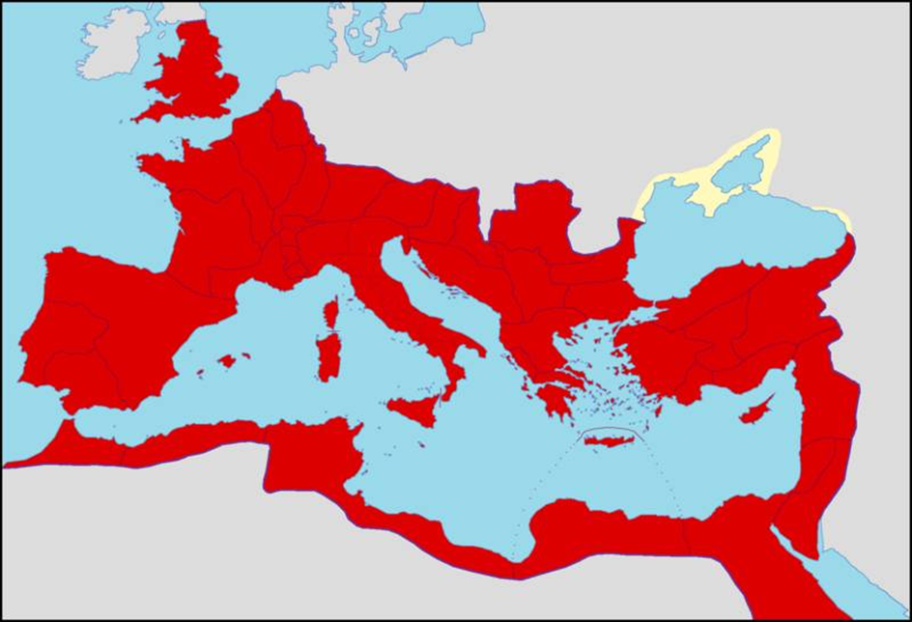
The Roman Empire, Late Third Century

Slide 9
Diocletian Splits the Empire
Emperor Diocletian (284-305)
Diocletian realized the Empire was too large ? complex for one ruler.
He also saw the bloody devastation brought about by the succession process (30 emperors in 100 years).
So he split the Empire in two – Easter and Western.
He tried to create a more productive succession process by creating a team of FOUR emperors – two senior (augustus) emperors and two junior (caesar) emperors – with a preset plan that the augustii would step down after ten years, the caesarii would become augustii and appoint their new caesarii.
Diocletian selected Maximian as his co-Emperor, with Galerius as caesar to Diocletian and Constantius I as caesar to Maximian.
It seemed to be working – there was a new peace and prosperity.

Slide 10
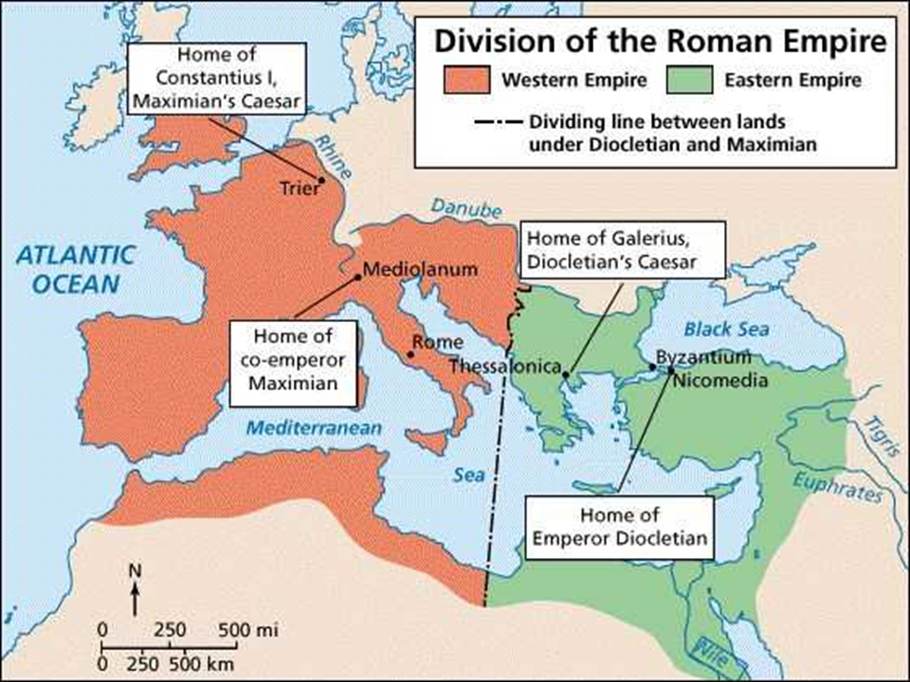

Slide 11
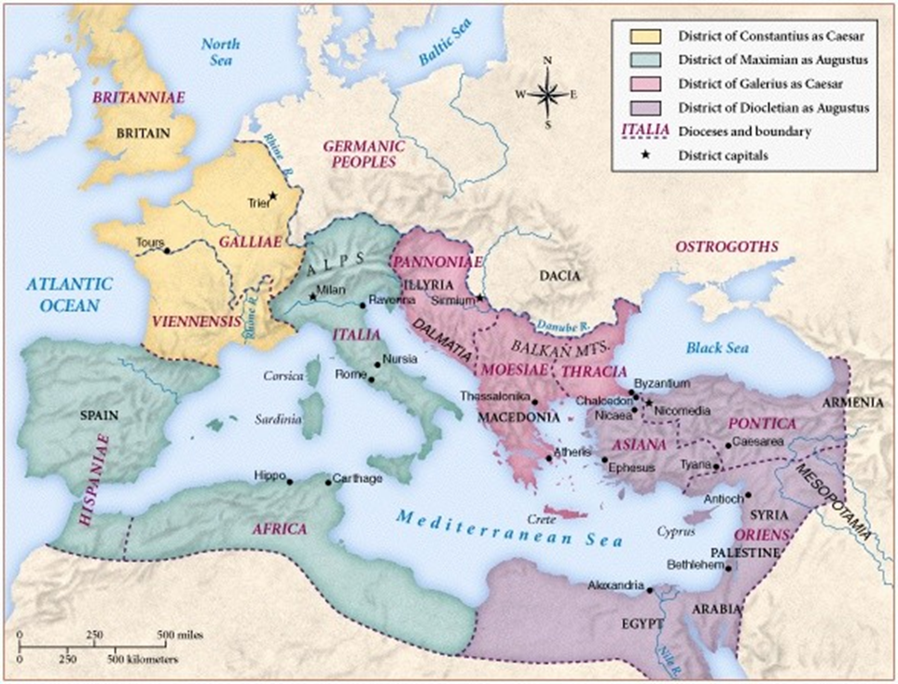

Slide 12
Diocletian Splits the Empire
Emperor Diocletian (284-305)
Diocletian realized the Empire was too large ? complex for one ruler.
He also saw the bloody devastation brought about by the succession process (30 emperors in 100 years).
So he split the Empire in two – Easter and Western.
He tried to create a more productive succession process by creating a team of FOUR emperors – two senior (augustus) emperors and two junior (caesar) emperors – with a preset plan that the augustii would step down after ten years, the caesarii would become augustii and appoint their new caesarii.
Diocletian selected Maximian as his co-Emperor, with Galerius as caesar to Diocletian and Constantius I as caesar to Maximian.
It seemed to be working – there was a new peace and prosperity.
Then, Galerius decided Christians should not be in military service, and convinced Diocletian to expel them from the army.
Galerius’ prejudice against Christians increased; eventually he convinced Diocletian to remove them from all government positions, & to destroy Christian building and books.
When some Christians refused to turn over their sacred writings, and after two suspicious fires in the imperial palace, Diocletian declared all Christians must sacrifice to the old gods.
So began the Great Persecution – the most cruel & widespread yet.

Slide 13
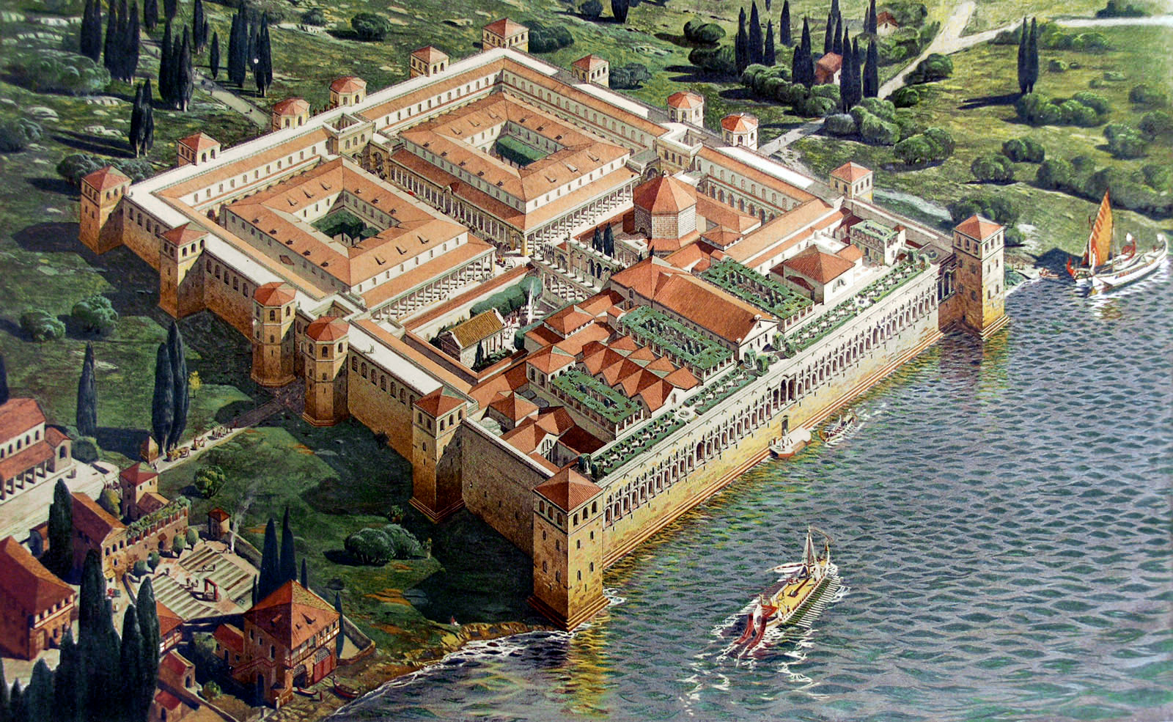

Slide 14
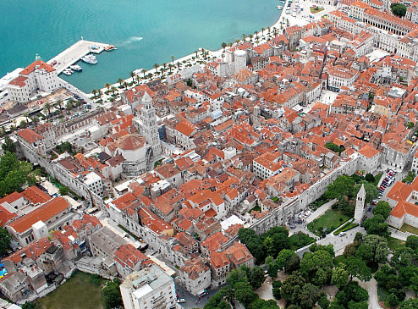

Slide 15
Emperor Diocletian and Other Emperors (284-305)
In 305 both Diocletian and Maximian abdicated, so Galerius and Constantius I took over as senior emperors. The two new caesarii (Severus and Maximinus Daia), however, were both loyal to Galerius, who had aspirations to rule alone.
When Constantius I died, the army legions under his son, Constantine, refused to accept the planned successor and declared Constantine their emperor.
Maximian’s son Maxentius siezed Rome, and Severus committed suicide. Galerius responded by invading the territories now controlled by Maxentius, but backed off when his troops started deserting to the other side.
Galerius asked Diocletian to come out of retirement to help, but he refused. He did, however, agree to help with negotiations – which led to a new augustus – Licinius – to serve alongside Galerius.
The persecutions continued everywhere except in territories now controlled by Constantine.
Galerius became very ill, and in 311 issued an edict ending the persecution of Christians, and asking them to pray for him. Galerius died five days later.
Constantine crossed the Alps and defeated Maxentius at the Battle of Milvian Bridge, outside Rome. In the process, Constantine had a vision from God and had his soldiers put a Christian symbol (chi rho) on their shields. He attributed his unlikely victory to the Christian God.

Slide 16
Emperor Constantine (306-337)
In 313 Constantine met with now co-emperor Licinius in Milan and signed the Edict of Milan, which ended persecution & gave freedom of religion to all in the Roman Empire, and a truce between the two of them. (The truce included Licinius marrying Constantine’s sister.)
In 322 Constantine invaded Licinius’ territory, on the pretext of chasing a band of looting barbarians. Licinius responded by gathering his (rather larger) army and meeting Constantine’s forces at Adrianople, where Constantine was victorious. Licinius fled to Byzantium. Constantine – negotiating through his sister/Licinius’ wife – promised to spare Licinius if he abdicated – which he did.
325 – Constantine is now sole ruler of the Roman Empire.
Under Constantine, all persecution ended and it was legal to be a Christian – for the first time in nearly 300 years.
Like Decius and Diocletian before him, Constantine is determined to make the Roman Empire great again; but unlike them, he believes the best way to do this is with Christianity as the basis.

Slide 17
Organization in the Early Church
By early 2nd Century, there were three distinct positions of authority within the Church – bishops, presbyters (elders) and deacons.
For a considerable time, the titles “bishop” and “elder” appear to have been interchangeable.
Bishops as “senior pastors” over the churches in a city or an area came about when some elders were recognized as having greater spiritual maturity and/or learning to help lead the Church, especially when persecuted.
Emphasis on the authority of bishops and on apostolic succession came especially in response to the challenge of heresies in the late 2nd and 3rd centuries.
By end of the 2nd century official leadership of the Church was entirely masculine, though there are indications of women in earlier leadership. This likely was due to prominent roles women had as leadership of some pre-Christian pagan cults, & especially within Gnosticism.

Slide 18
The Question of the Lapsed
The persecutions of Decius and Valerian caused many Christians to renounce their faith and worship pagan gods.
Afterwards, the Church was confronted with what to do with these “lapsed” Christians who wished to return.
The problem: not all had fallen in the same way. Should the Church deal differently with whose who had quickly conceded to Imperial demands, versus those who fled in the face of persecution, versus those who had purchased false libellum but had not actually committed apostasy, versus those who had only lapsed after being viciously tortured?
Those who survived persecution & torture without lapsing – the “confessors” – were highly regarded & held by many to be more spiritual. So some looked to these “confessors” to decide how to treat those who had lapsed.
Cyprian of Carthage – a bishop who had fled persecution (and so accused by some of cowardice) who insisted that the bishops and other Church leaders (and NOT the “confessors”) must decide on the lapsed. A schism (split) resulted in both the churches of Carthage and Rome.
This issue continued to affect the Church for generations.

Slide 19
The Cult of the Martyrs
With many Christians lapsing under persecutions of Decius and Valerian, those who died as martyrs under ALL persecutions came to be highly honored and revered.
The cult of the martyrs (worship activities associated with martyrs and/or their remains) was influenced by the Greek hero cults and Greco-Roman funerary practices.
Cyprian was the first to refer to the eucharist as an offering in memory of the martyrs.
Christians started celebrating the date of death of martyrs as their “birthday” – the day they were born into eternal life.
At first, prayers & memorial ceremonies were simply held in the tombs. Then came the idea that prayers were actually more effective when done in the presence of martyr remains. (Which led to the practice of removing remains of martyrs from tombs and placing them in churches, so there came to be a great demand for the remains of martyrs.)
This then led to the idea that the departed martyrs and saints – being in the presence of God and free to speak directly to Him – could pray with and for living Christians: the intercession of the saints.

