Slide 1
New Testament Survey (NT1)
Paul the Apostle & Pauline Epistles 2
Romans, Ephesians, Colossians, Philemon,
Philippians, 1-2 Timothy, Titus
Ross Arnold, Winter 2013 Lakeside institute of Theology

Slide 2
New Testament Survey (NT1)
Introduction to New Testament Theology
The Synoptic Gospels – Matthew, Mark & Luke
Gospel of John; Book of Acts
Paul & Pauline Epistles (Galatians, 1-2 Thessalonians, 1-2 Corinthians)
Pauline Epistles 2 (Romans, Philemon, Colossians, Ephesians, Philippians, 1-2 Timothy, Titus)
The General Epistles (Hebrews to Jude)
Book of Revelation; Expectations for Fulfillment
New Testament Conclusion; Final Exam

Slide 3
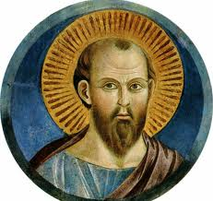
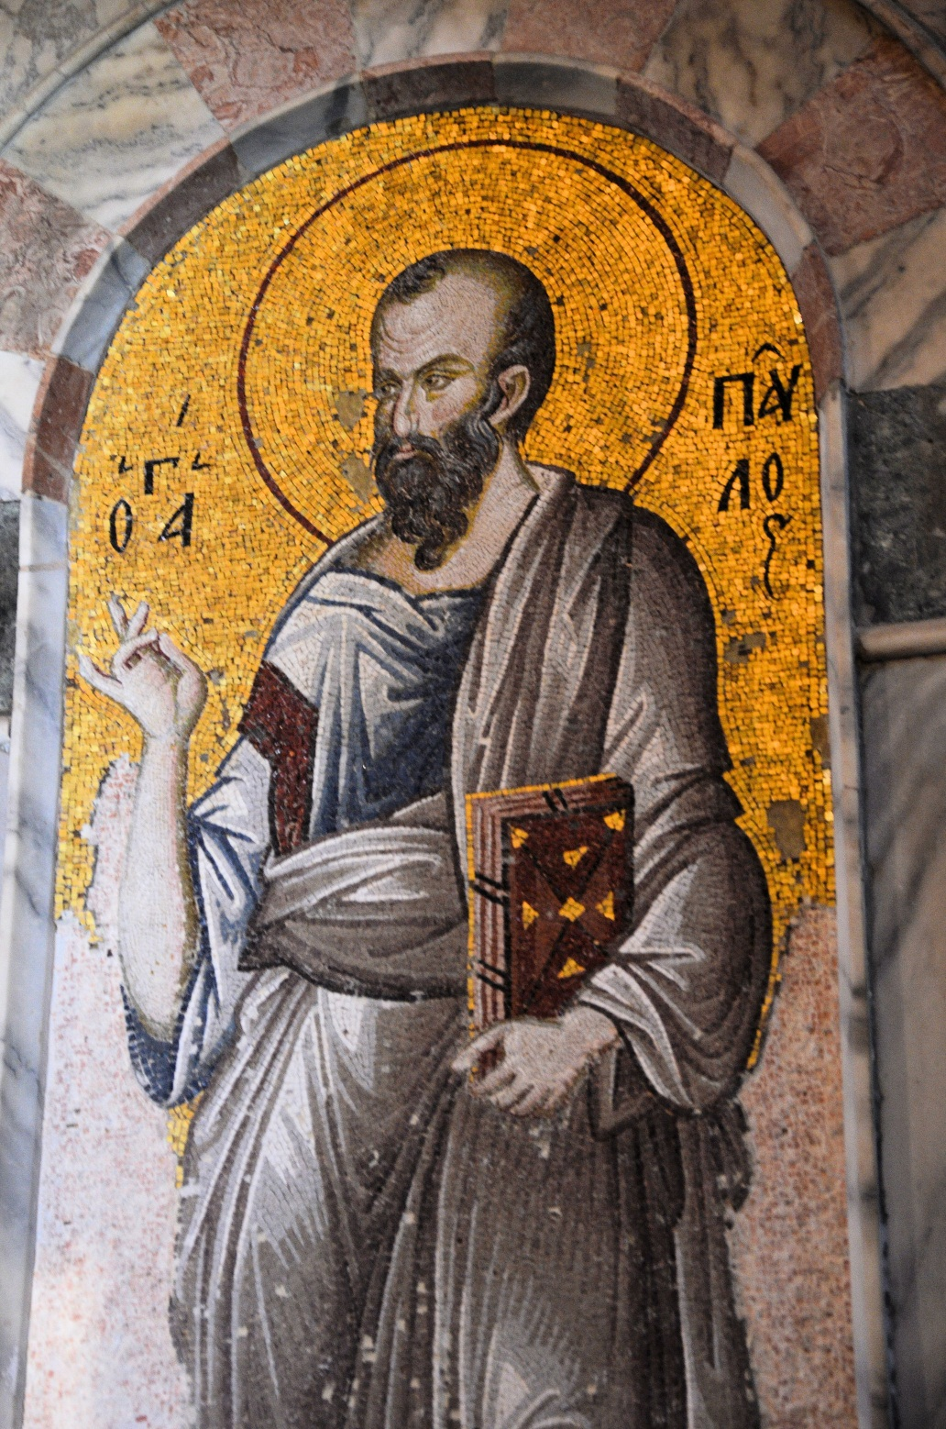
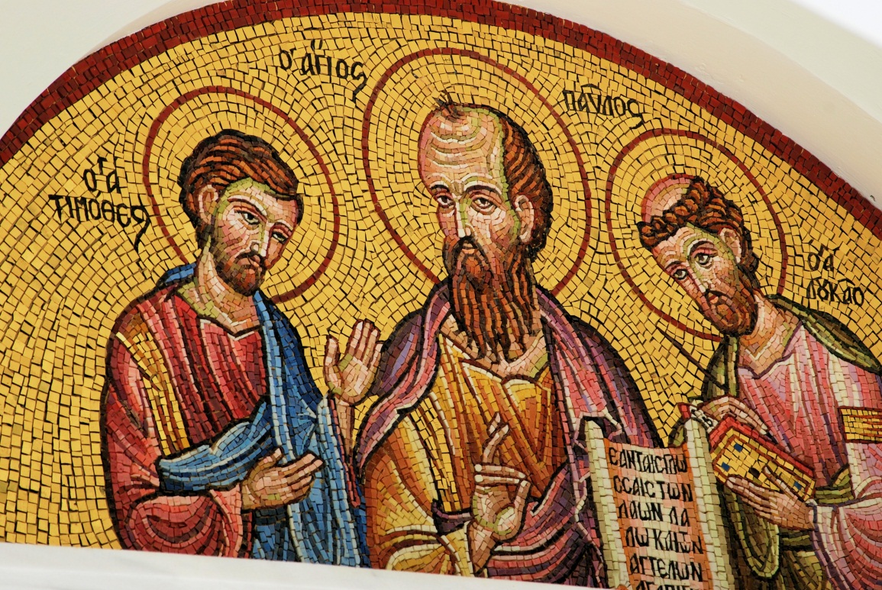

Slide 4
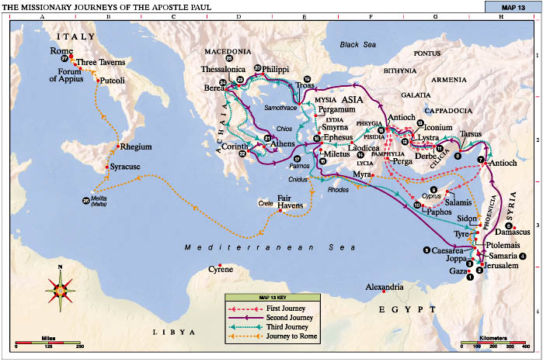

Slide 5
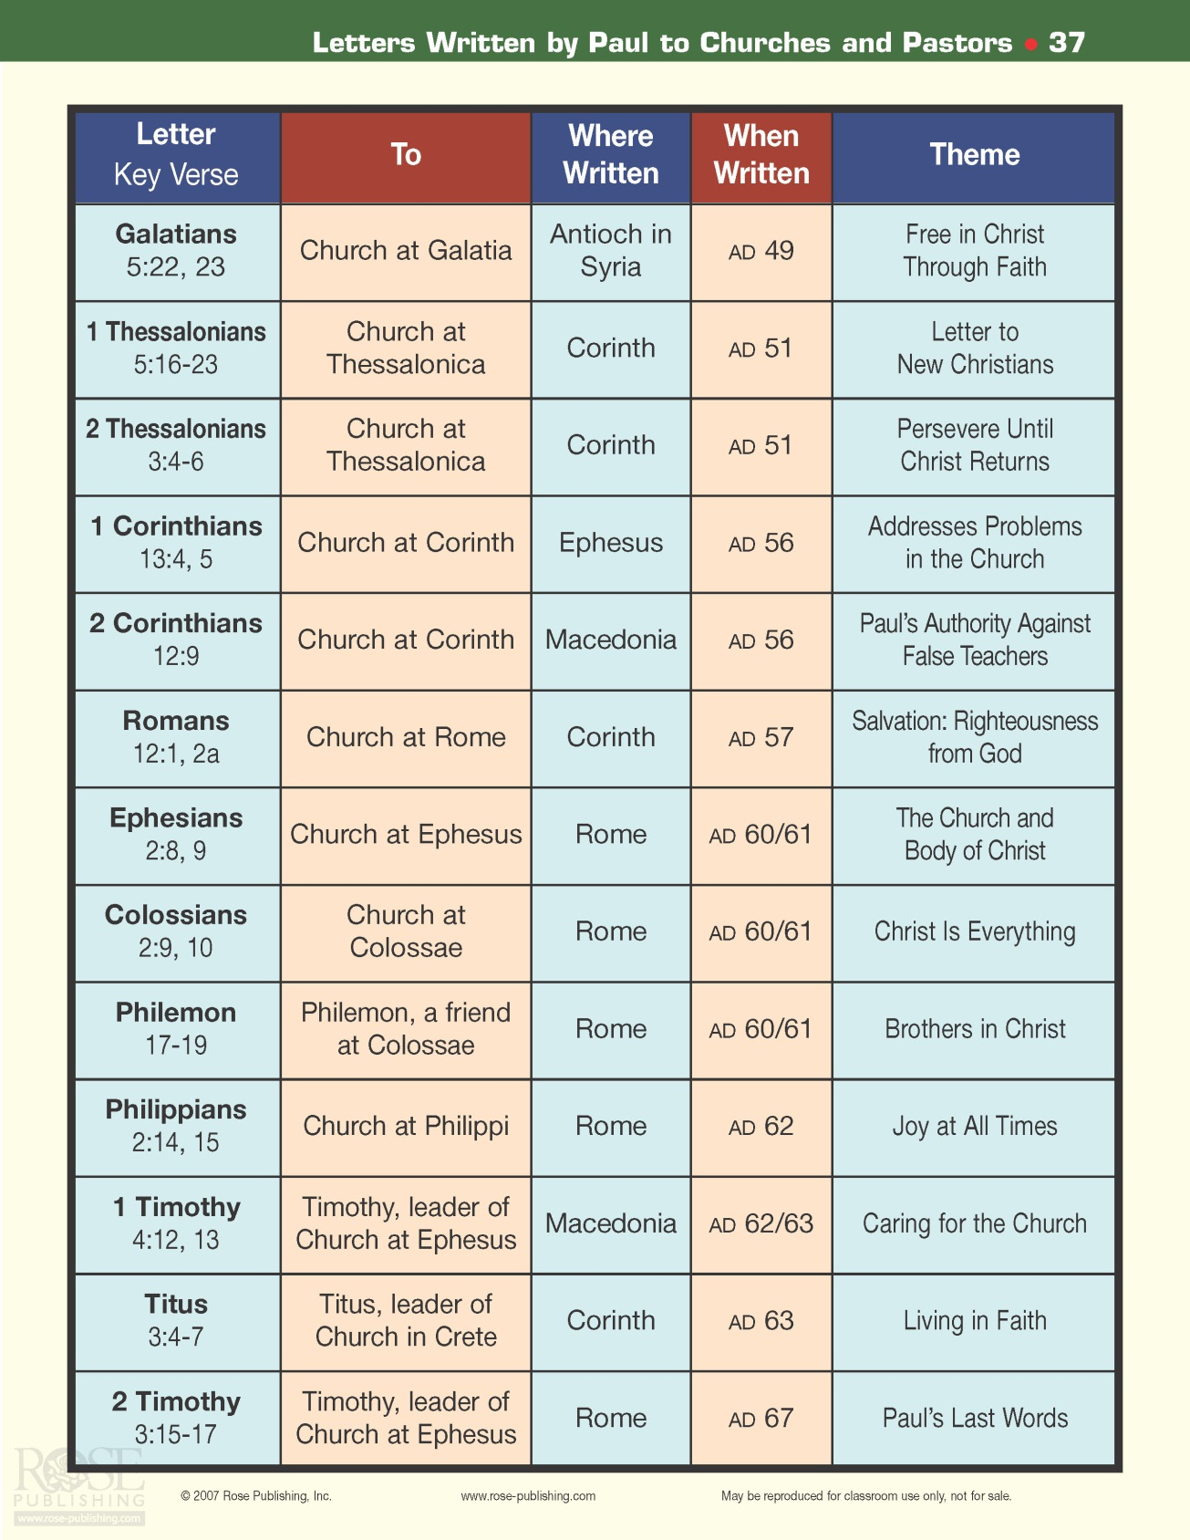

Slide 6
The Letters of Paul the Apostle
Galatians – Necessity of salvation by grace rather than the Law, to the churches in Galatia.
1-2 Thessalonians – Instruction on the coming of the Lord for church at Thessalonica.
1-2 Corinthians – Instructions in the faith, and Paul’s defense of his apostleship, to the church in Corinth.
Romans – Explanation of the Christian faith, to the church in Rome.
Ephesians – Explanation of believer’s position in Christ, to the church in Ephesus.
Colossians – Account of the supremacy of Christ, for the church at Colossae.
Philemon – Appeal for Christian unity and forgiveness for a runaway slave.
Philippians – Joyful letter about Paul’s faith during imprisonment, to the church at Philippi.
1-2 Timothy – Manuals of leadership for a young pastor at Ephesus.
Titus – Manual of conduct for Christian leaders, especially a young pastor on Crete.

Slide 8
The Book of Romans
Author: Apostle Paul
Date: c. AD 56-57
Theme: The whole Gospel: God’s plan of salvation and righteousness to Gentile & Jew, written to the church in Rome, power center of civilization at that time.
Purpose: To prepare for his coming visit to Rome; present the plan of salvation; explain how Jews & Gentiles fit into God’s plan.
Outline: *Revelation of God’s Righteousness (1-8)
*Vindication of God’s Righteousness (9-11)
*Application of God’s Righteousness (12-16)

Slide 9
The Book of Romans – Key Verses
I am not ashamed of the gospel, because it is the power of God for the salvation of everyone who believes: first for the Jew, then for the Gentile. ¹⁷ For in the gospel a righteousness from God is revealed, a righteousness that is by faith from first to last, just as it is written: "The righteous will live by faith."
Romans 1:16-17
But now a righteousness from God, apart from law, has been made known, to which the Law and the Prophets testify. ²² This righteousness from God comes through faith in Jesus Christ to all who believe. There is no difference, ²³ for all have sinned and fall short of the glory of God, ²⁴ and are justified freely by his grace through the redemption that came by Christ Jesus. ²⁵ God presented him as a sacrifice of atonement, through faith in his blood. He did this to demonstrate his justice, because in his forbearance he had left the sins committed beforehand unpunished…
Romans 3:21-26

Slide 10
The Book of Ephesians
Author: Apostle Paul
Date: c. AD 60-63
Theme: Relationship of heavenly Lord Jesus Christ and His earthly body, the Church.
Purpose: To increase understanding of God’s eternal purpose and grace, and of God’s high goals for the Church.
Outline: *Position of the Christian (1-3)
* Practice of the Christian (4-6)

Slide 11
The Book of Ephesians – Key Verses
For it is by grace you have been saved, through faith - and this not from yourselves, it is the gift of God - ⁹ not by works, so that no one can boast. ¹⁰ For we are God's workmanship, created in Christ Jesus to do good works, which God prepared in advance for us to do.
Ephesians 2:8-10
As a prisoner for the Lord, then, I urge you to live a life worthy of the calling you have received. ² Be completely humble and gentle; be patient, bearing with one another in love. ³ Make every effort to keep the unity of the Spirit through the bond of peace. ⁴ There is one body and one Spirit - just as you were called to one hope when you were called - ⁵ one Lord, one faith, one baptism; ⁶ one God and Father of all, who is over all and through all and in all.
Ephesians 4:1-6

Slide 12
The Book of Colossians
Author: Apostle Paul
Date: c. AD 60-63
Theme: To oppose Jewish and Gnostic false teaching that has taken root in the church in Colossae.
Purpose: To exalt Christ as completely adequate, versus the inadequate heresies the Colossians had come to believe.
Outline: *Supremacy of Christ (1-2)
*Submission to Christ (3-4)

Slide 13
The Book of Colossians – Key Verses
For in Christ all the fullness of the Deity lives in bodily form, ¹⁰ and you have been given fullness in Christ, who is the head over every power and authority.
Colossians 2:9-10
Since, then, you have been raised with Christ, set your hearts on things above, where Christ is seated at the right hand of God. ² Set your minds on things above, not on earthly things.
Colossians 3:1-2

Slide 14
The Book of Philemon
Author: Apostle Paul
Date: c. AD 60-63
Theme: Fellowship in Christ as superior to cultural or social status (as between slave and owner).
Purpose: To encourage Philemon to receive back a runaway slave, Onesimus, who is a Christian brother, as a service and personal favor to Paul.
Outline: *Prayer of Thanksgiving for Philemon (vv. 1-7)
*Petition for Onesimus (vv. 8-16)
*Promise of Paul to Philemon (vv. 17-25)

Slide 15
The Book of Philemon – Key Verses
I am sending him - who is my very heart - back to you. ¹³ I would have liked to keep him with me so that he could take your place in helping me while I am in chains for the gospel. ¹⁴ But I did not want to do anything without your consent, so that any favor you do will be spontaneous and not forced. ¹⁵ Perhaps the reason he was separated from you for a little while was that you might have him back for good - ¹⁶ no longer as a slave, but better than a slave, as a dear brother. He is very dear to me but even dearer to you, both as a man and as a brother in the Lord.
¹⁷ So if you consider me a partner, welcome him as you would welcome me. ¹⁸ If he has done you any wrong or owes you anything, charge it to me. ¹⁹ I, Paul, am writing this with my own hand. Philemon 12-19

Slide 16
The Book of Philippians
Author: Apostle Paul
Date: c. AD 60-63
Theme: The Christ-centered life, the sign of which is joy.
Purpose: To thank the Philippians, report on his circumstances, encourage the church under persecution, exhort them to humility and warn against false teachers.
Outline: *Paul’s Present Circumstances (1)
*Appeal to Have the Mind of Christ (2)
*Appeal to Have Knowledge of Christ (3)
*Appeal to Have the Peace of Christ (4)

Slide 17
The Book of Philippians – Key Verses
For to me, to live is Christ and to die is gain.
Philippians 1:21
I have learned to be content whatever the circumstances. ¹² I know what it is to be in need, and I know what it is to have plenty. I have learned the secret of being content in any and every situation, whether well fed or hungry, whether living in plenty or in want. ¹³ I can do everything through him who gives me strength.
Philippians 4:11-13

Slide 18
The Book of 1 Timothy
Author: Apostle Paul
Date: c. AD 62-66
Theme: Sound doctrine and godliness as best ministry approach against false teaching and apostasy.
Purpose: To provide a guide for church organization to Timothy, young pastor of the church in Ephesus.
Outline: *Charge Concerning Doctrine (1)
*Charge Concerning Public Worship (2-3)
*Charge Concerning False Teachers (4)
*Charge Concerning Church Discipline (5)
*Charge Concerning Pastoral Duties (6)

Slide 19
The Book of 1 Timothy – Key Verses
I am writing you these instructions so that, ¹⁵ if I am delayed, you will know how people ought to conduct themselves in God's household, which is the church of the living God, the pillar and foundation of the truth. ¹⁶ Beyond all question, the mystery of godliness is great:
He appeared in a body, was vindicated by the Spirit, was seen by angels, was preached among the nations, was believed on in the world, was taken up in glory. 1 Timothy 3:14-16
But you, man of God, flee from all this, and pursue righteousness, godliness, faith, love, endurance and gentleness. ¹² Fight the good fight of the faith. Take hold of the eternal life to which you were called when you made your good confession in the presence of many witnesses. 1 Timothy 6:11-12

Slide 20
The Book of Titus
Author: Apostle Paul
Date: c. AD 62-66
Theme: Emphasis on “doing what is good” as well as classic summaries of Christian doctrine.
Purpose: To give Titus, whom Paul left to care for the church they planted on Crete, guidance in meeting opposition, instruction about faith and conduct, and warning about false teachers.
Outline: *Appointing Elders (1)
*Setting Everything in Order (2-3)

Slide 21
The Book of Titus – Key Verses
At one time we too were foolish, disobedient, deceived and enslaved by all kinds of passions and pleasures. We lived in malice and envy, being hated and hating one another. ⁴ But when the kindness and love of God our Savior appeared, ⁵ he saved us, not because of righteous things we had done, but because of his mercy. He saved us through the washing of rebirth and renewal by the Holy Spirit, ⁶ whom he poured out on us generously through Jesus Christ our Savior, ⁷ so that, having been justified by his grace, we might become heirs having the hope of eternal life. ⁸ This is a trustworthy saying. And I want you to stress these things, so that those who have trusted in God may be careful to devote themselves to doing what is good. These things are excellent and profitable for everyone.
Titus 3:3-8

Slide 22
The Book of 2 Timothy
Author: Apostle Paul
Date: c. AD 66-67
Theme: Paul knows his work is done and his time is short, so he writes to his beloved Timothy.
Purpose: To ask Timothy to come to him in Rome; to admonish Timothy to guard and maintain the Gospel during Nero’s persecution; to communicate with the church in Ephesus.
Outline: *Persevere in Present Testing (1-2)
*Endure in Future Testing (3-4)

Slide 23
The Book of 2 Timothy – Key Verses
You then, my son, be strong in the grace that is in Christ Jesus. ² And the things you have heard me say in the presence of many witnesses entrust to reliable men who will also be qualified to teach others. ³ Endure hardship with us like a good soldier of Christ Jesus. ⁴ No one serving as a soldier gets involved in civilian affairs - he wants to please his commanding officer.
2 Timothy 2:1-4
But as for you, continue in what you have learned and have become convinced of, because you know those from whom you learned it, ¹⁵ and how from infancy you have known the holy Scriptures, which are able to make you wise for salvation through faith in Christ Jesus. ¹⁶ All Scripture is God-breathed and is useful for teaching, rebuking, correcting and training in righteousness, ¹⁷ so that the man of God may be thoroughly equipped for every good work.
2 Timothy 3:14-17

