Slide 1
New Testament Survey (NT1)
Paul the Apostle & Pauline Epistles 1
Galatians, 1-2 Thessalonians, 1-2 Corinthians
Ross Arnold, Winter 2013 Lakeside institute of Theology

Slide 2
New Testament Survey (NT1)
Introduction to New Testament Theology
The Synoptic Gospels – Matthew, Mark & Luke
Gospel of John; Book of Acts
Paul & Pauline Epistles (Galatians, 1-2 Thessalonians, 1-2 Corinthians)
Pauline Epistles 2 (Romans, Philemon, Colossians, Ephesians, Philippians, 1-2 Timothy, Titus)
The General Epistles (Hebrews to Jude)
Book of Revelation; Expectations for Fulfillment
New Testament Conclusion; Final Exam

Slide 3
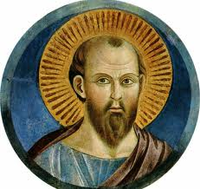
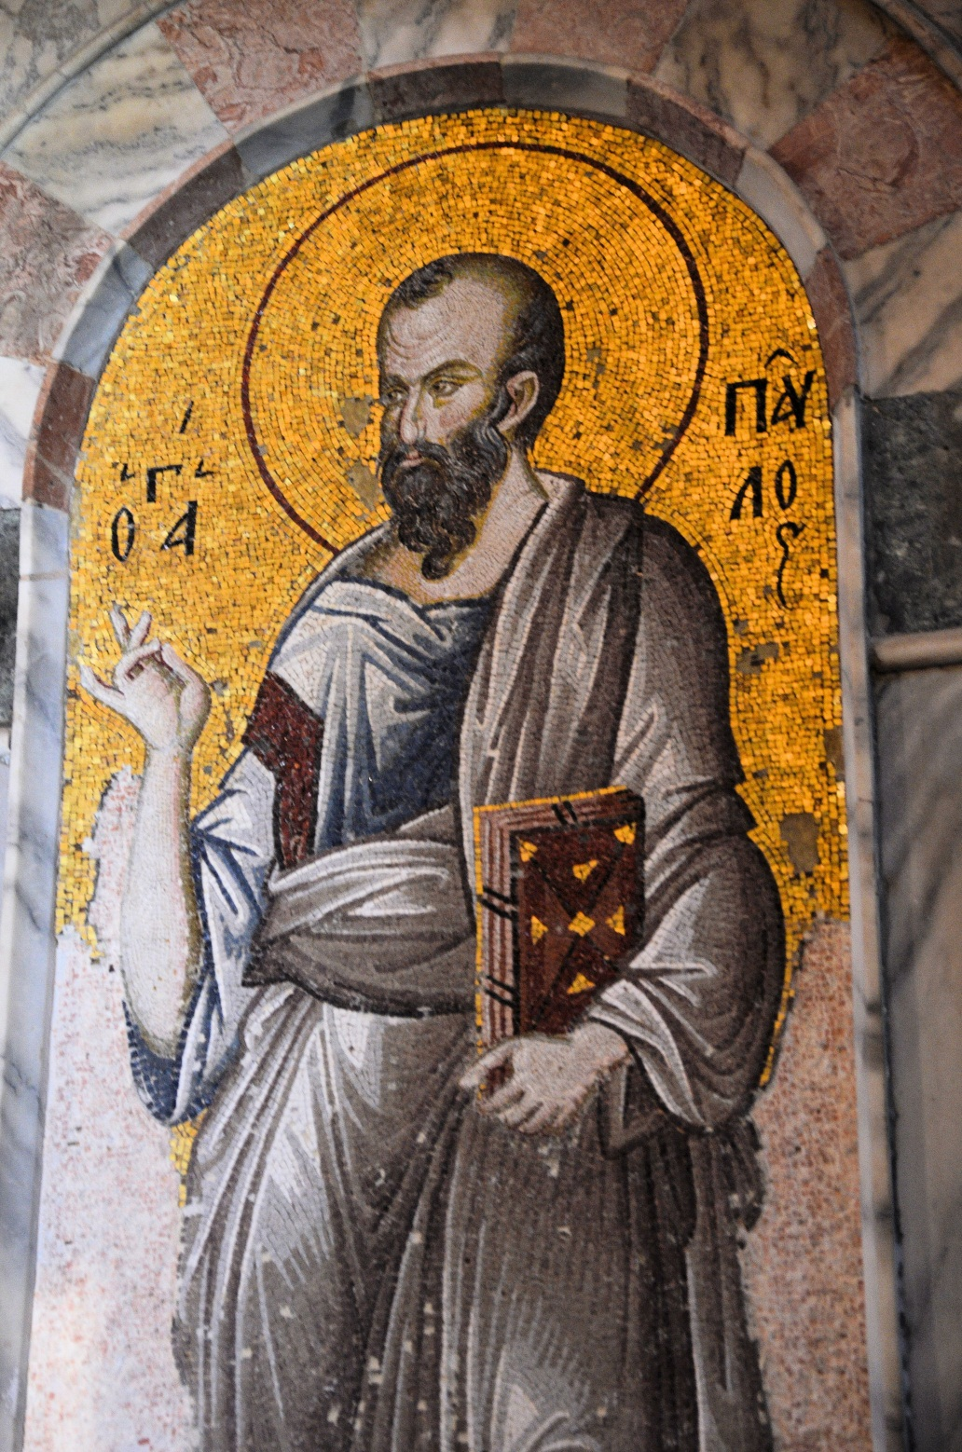
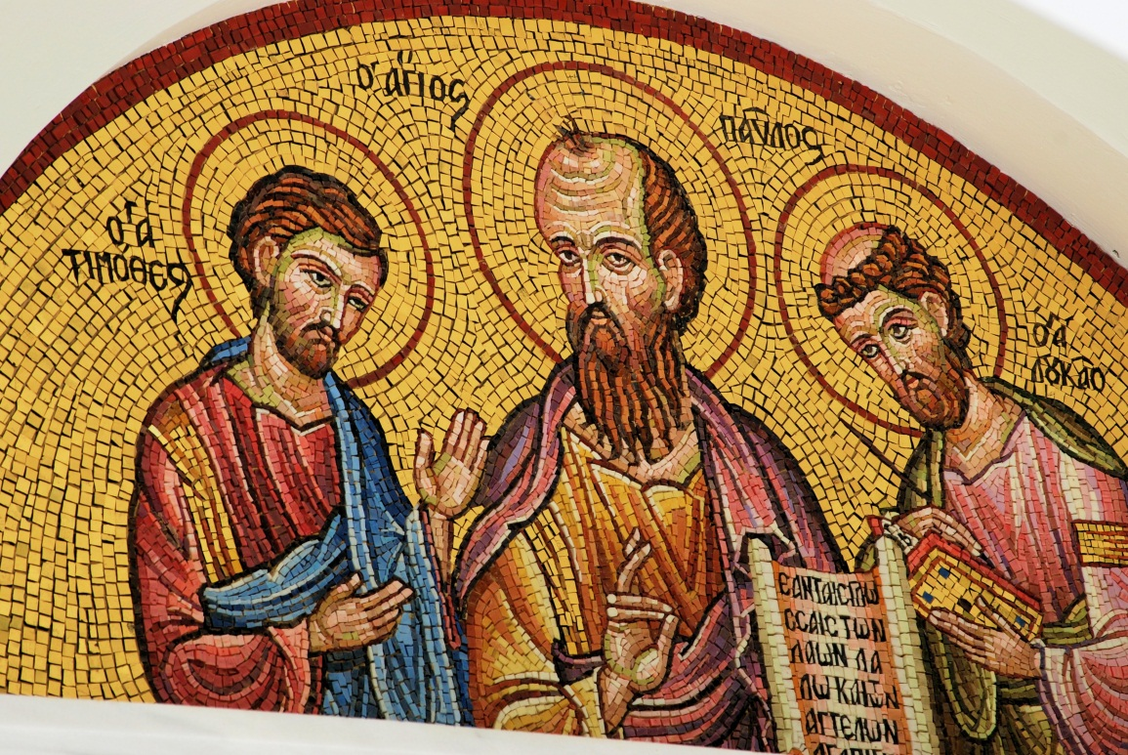

Slide 4
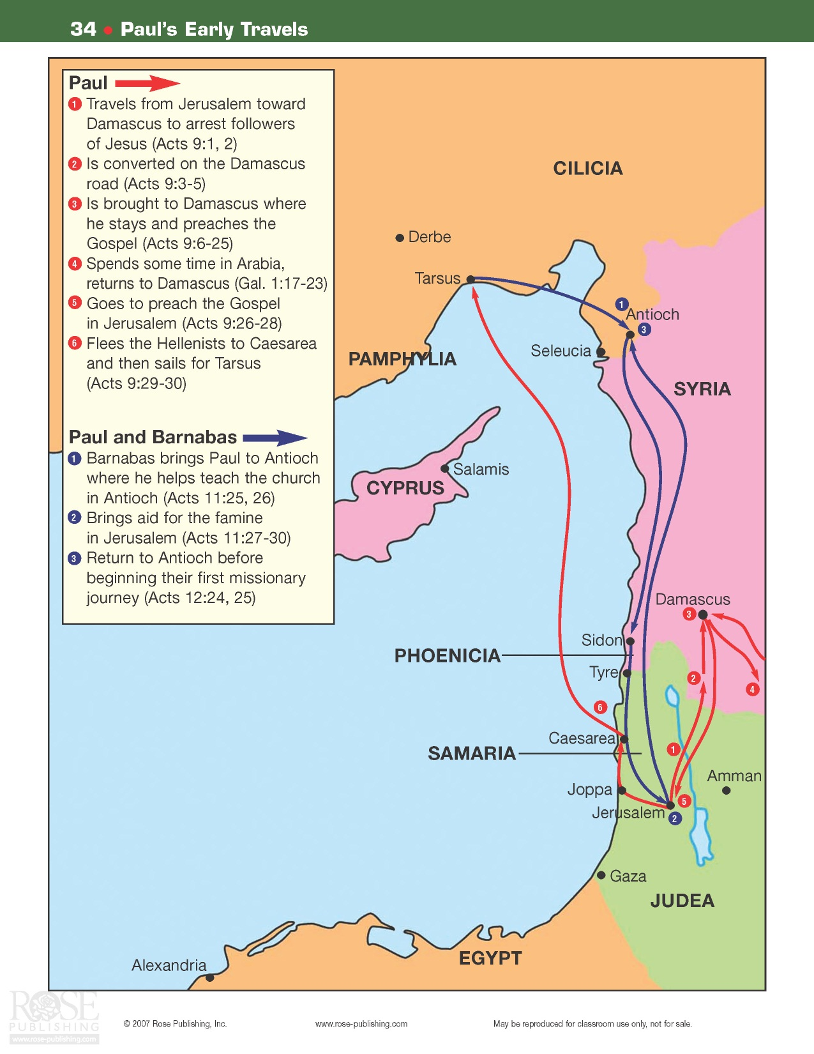

Slide 5
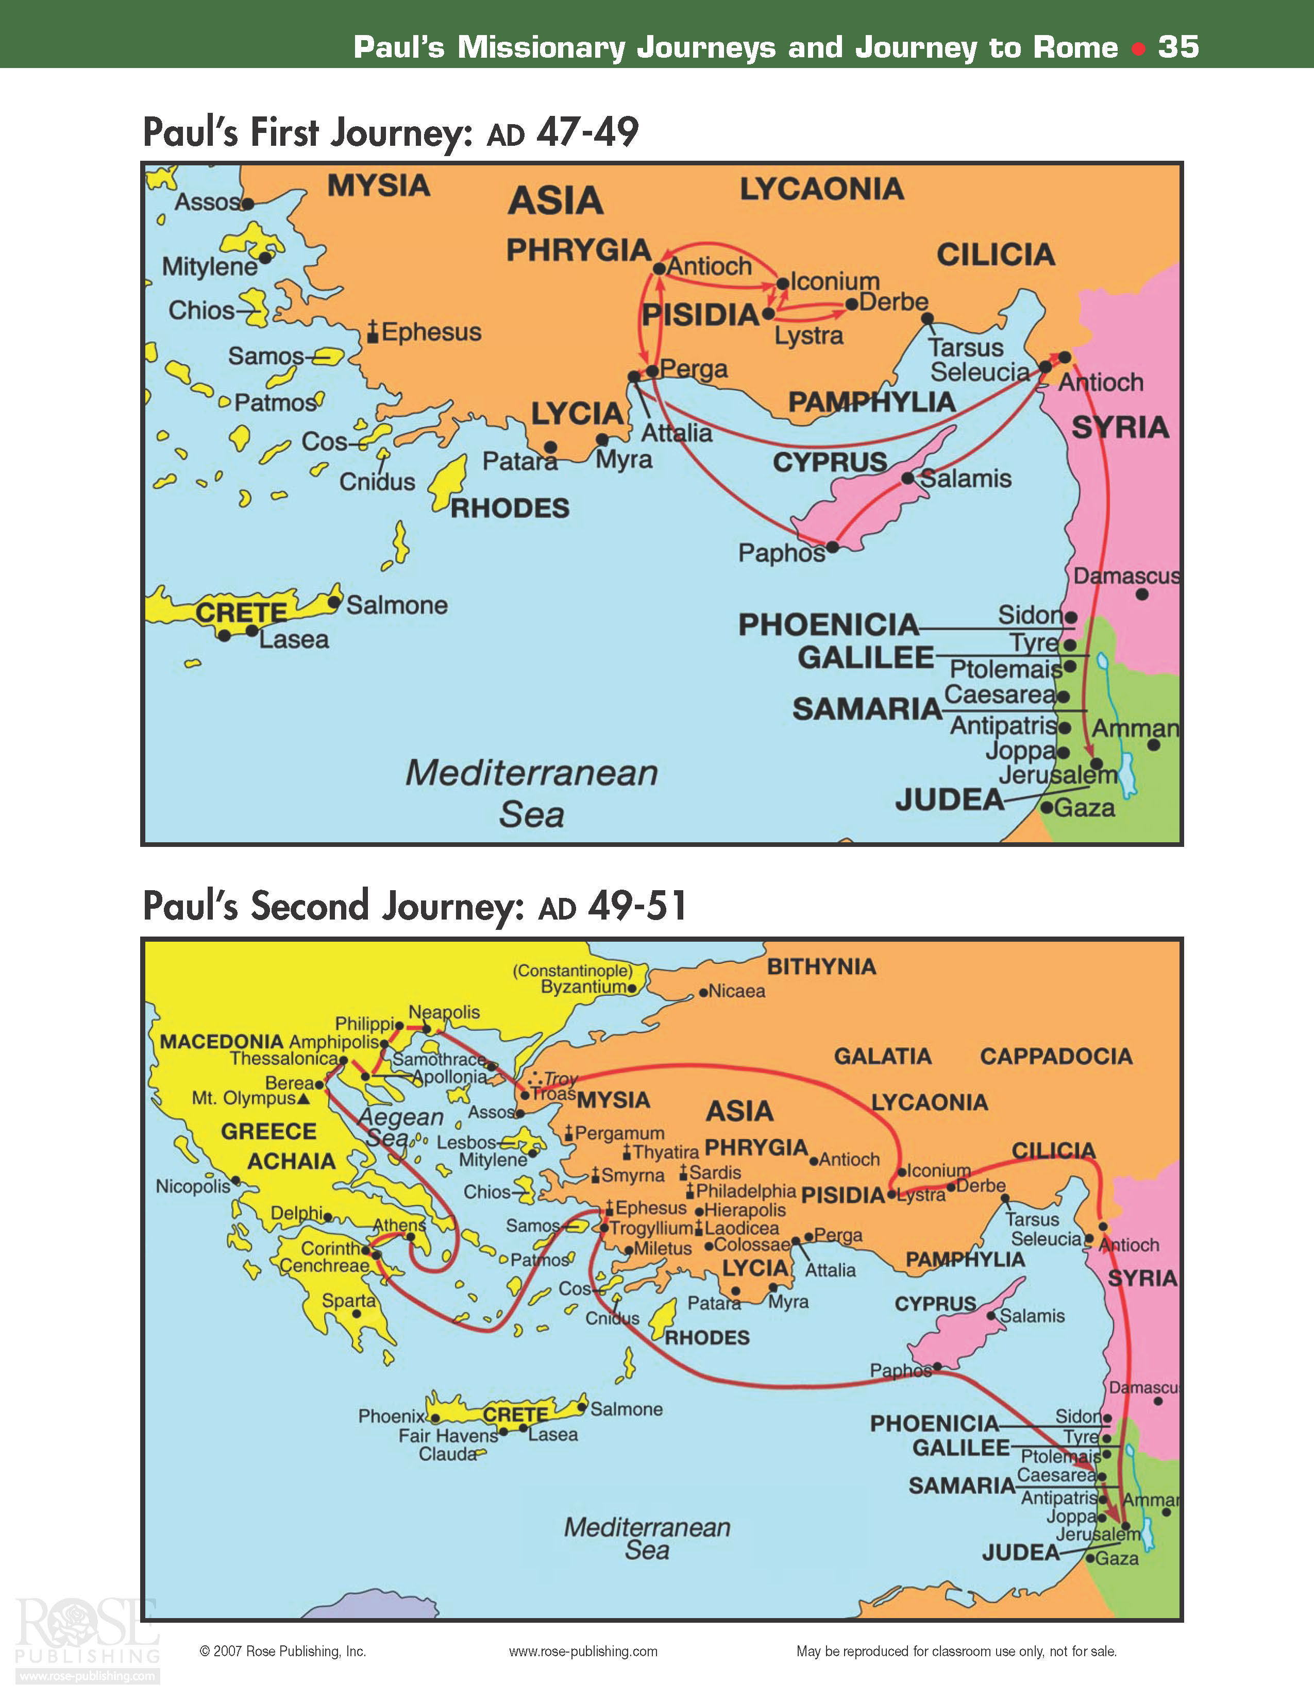

Slide 7
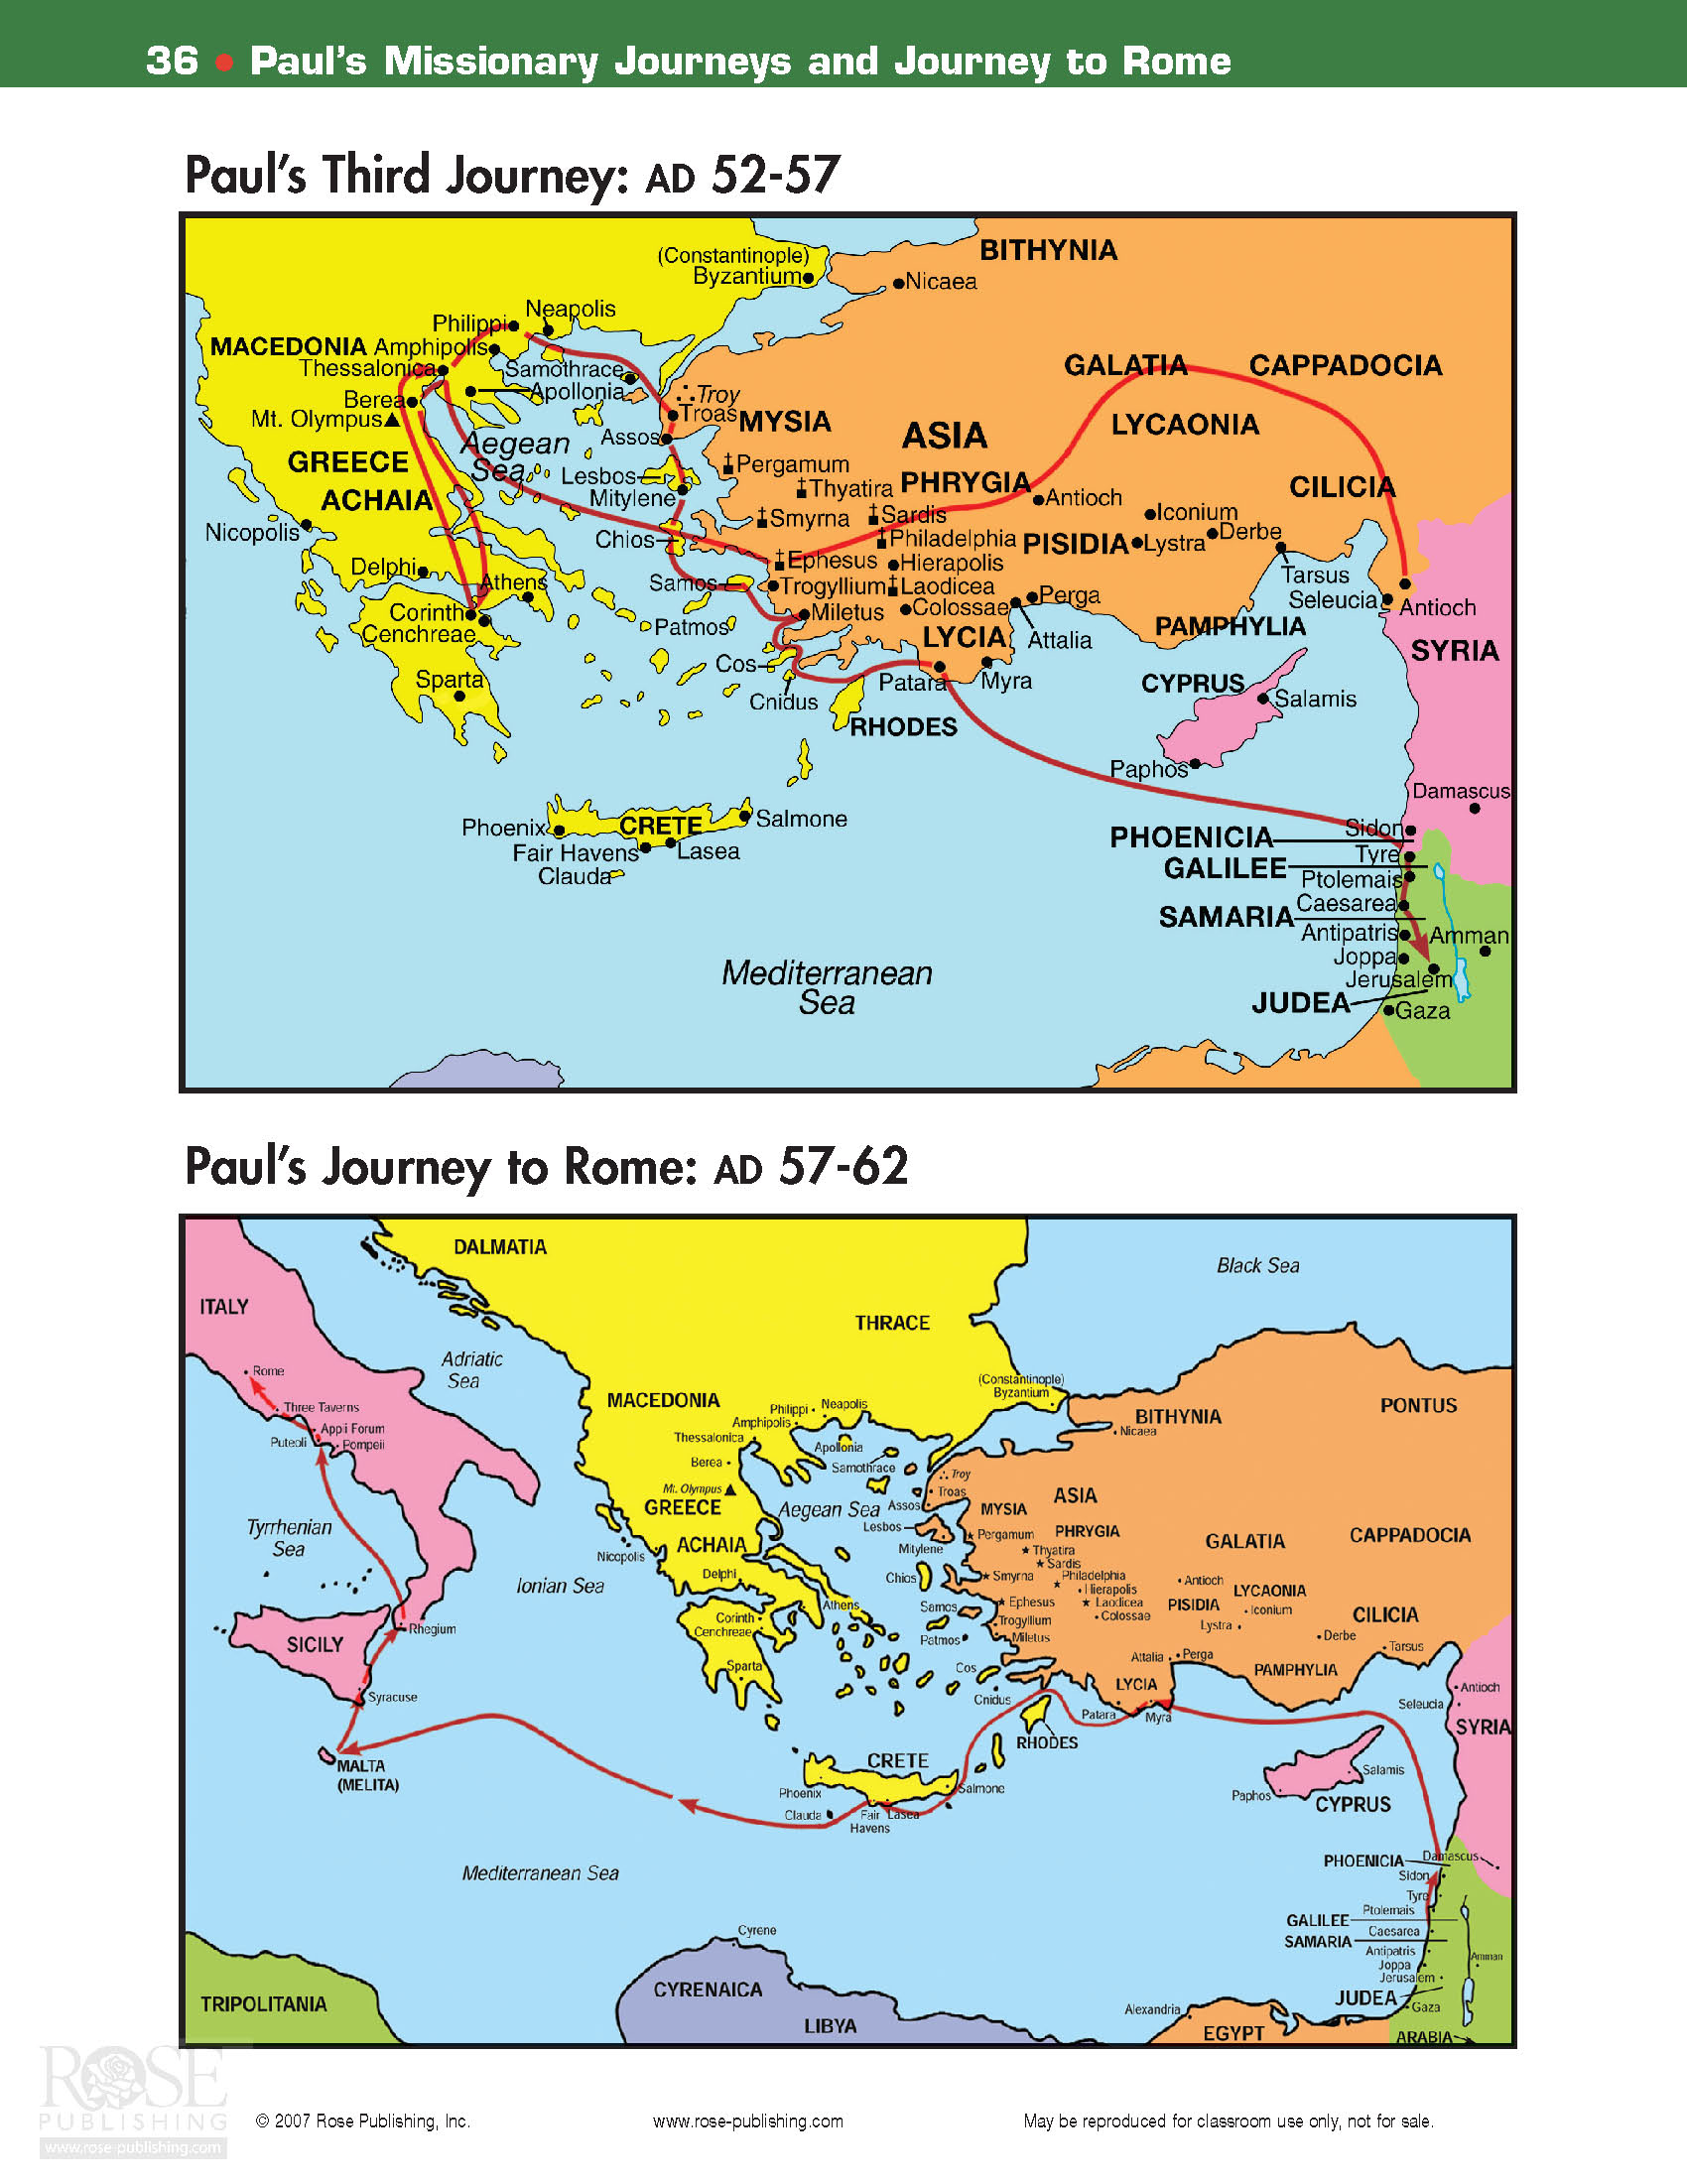

Slide 9
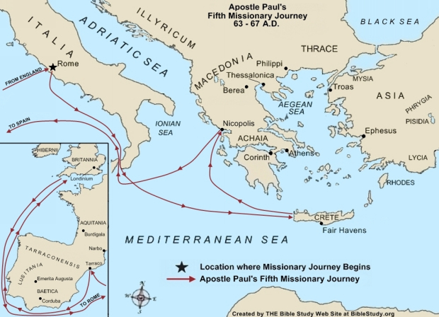

Slide 10
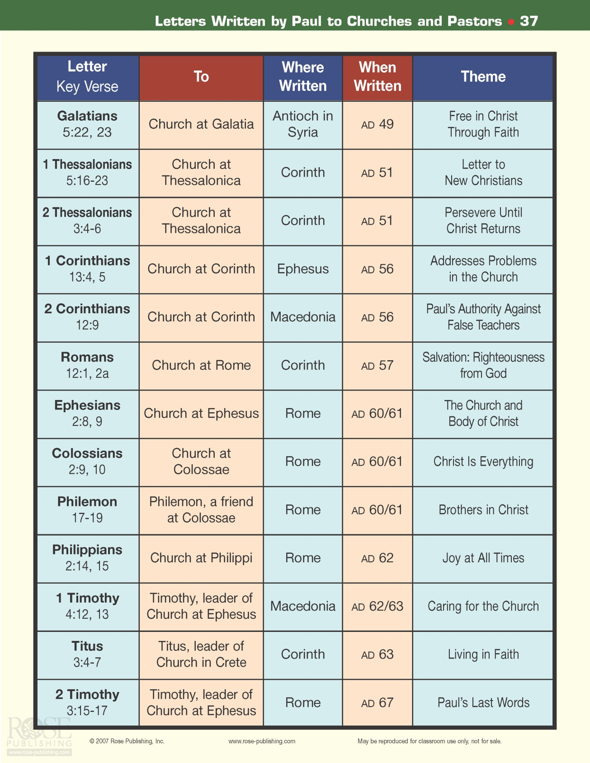

Slide 11
The Book of Galatians
Author: Apostle Paul
Date: c. AD 49
Theme: Salvation is by grace alone, and the Old Testament Law is not only unnecessary, but harmful.
Purpose: To correct the false teaching of Judaizers who had misled the Galatian churches after Paul planted them.
Outline: *Gospel of Grace Defended (1-2)
*Gospel of Grace Explained (3-4)
*Gospel of Grace Applied (5-6)

Slide 12
The Book of Galatians Key Verses
I have been crucified with Christ and I no longer live, but Christ lives in me. The life I live in the body, I live by faith in the Son of God, who loved me and gave himself for me. ²¹ I do not set aside the grace of God, for if righteousness could be gained through the law, Christ died for nothing!
Galatians 2:20-21
It is for freedom that Christ has set us free. Stand firm, then, and do not let yourselves be burdened again by a yoke of slavery.
Galatians 5:1

Slide 13
The Book of 1 Thessalonians
Author: Apostle Paul
Date: c. AD 51-52
Theme: Primarily an emphasis on the Second Coming of Christ.
Purpose: To provide instruction, support and encouragement to a young church in time of persecution.
Outline: *Personal Reflections on Thessalonians (1-3)
*Instructions for the Thessalonians (4-5)

Slide 14
The Book of 1 Thessalonians Key Verses
May the Lord make your love increase and overflow for each other and for everyone else, just as ours does for you. ¹³ May he strengthen your hearts so that you will be blameless and holy in the presence of our God and Father when our Lord Jesus comes with all his holy ones.
1 Thessalonians 3:12-13
For the Lord himself will come down from heaven, with a loud command, with the voice of the archangel and with the trumpet call of God, and the dead in Christ will rise first. ¹⁷ After that, we who are still alive and are left will be caught up together with them in the clouds to meet the Lord in the air. And so we will be with the Lord forever. ¹⁸ Therefore encourage each other with these words.
1 Thessalonians 4:16-18

Slide 15
The Book of 2 Thessalonians
Author: Apostle Paul
Date: c. AD 51-52
Theme: Presents an extensive eschatology.
Purpose: Similar to 1 Thess. – encourage persecuted believers, exhort to be steadfast and work, correct misunderstandings on Lord’s return.
Outline:*Encouragement in Persecution (1)
*Explanation of the Day of the Lord (2)
*Exhortation to the Church (3)

Slide 16
The Book of 2 Thessalonians Key Verses
Concerning the coming of our Lord Jesus Christ and our being gathered to him, we ask you, brothers, ² not to become easily unsettled or alarmed by some prophecy, report or letter supposed to have come from us, saying that the day of the Lord has already come. ³ Don't let anyone deceive you in any way, for that day will not come until the rebellion occurs and the man of lawlessness is revealed, the man doomed to destruction.
2 Thessalonians 2:1-3
…from the beginning God chose you to be saved through the sanctifying work of the Spirit and through belief in the truth. ¹⁴ He called you to this through our gospel, that you might share in the glory of our Lord Jesus Christ. ¹⁵ So then, brothers, stand firm and hold to the teachings we passed on to you, whether by word of mouth or by letter.
2 Thessalonians 2:13-15

Slide 17
The Book of 1 Corinthians
Author: Apostle Paul
Date: c. AD 55-56
Theme: Problems in Christian conduct in the Corinthian church, including immaturity, divisions, jealousy, immorality and false teaching.
Purpose: To promote greater maturity in the church in one of Greece’s major cities.
Outline:*Answer to Report of Divisions (1-4)
*Answer to Report of Fornication (5-6)
*Answer to Letter of Questions (7-16)

Slide 18
The Book of 1 Corinthians Key Verses
Do you not know that your body is a temple of the Holy Spirit, who is in you, whom you have received from God? You are not your own; ²⁰ you were bought at a price. Therefore honor God with your body.
1 Corinthians 6:19-20
No temptation has seized you except what is common to man. And God is faithful; he will not let you be tempted beyond what you can bear. But when you are tempted, he will also provide a way out so that you can stand up under it.
1 Corinthians 10:13

Slide 19
The Book of 1 Corinthians Key Verses
If I speak in the tongues of men and of angels, but have not love, I am only a resounding gong or a clanging cymbal. ² If I have the gift of prophecy and can fathom all mysteries and all knowledge, and if I have a faith that can move mountains, but have not love, I am nothing. ³ If I give all I possess to the poor and surrender my body to the flames, but have not love, I gain nothing.
⁴ Love is patient, love is kind. It does not envy, it does not boast, it is not proud. ⁵ It is not rude, it is not self-seeking, it is not easily angered, it keeps no record of wrongs. ⁶ Love does not delight in evil but rejoices with the truth. ⁷ It always protects, always trusts, always hopes, always perseveres.
⁸ Love never fails. But where there are prophecies, they will cease; where there are tongues, they will be stilled; where there is knowledge, it will pass away. ⁹ For we know in part and we prophesy in part, ¹⁰ but when perfection comes, the imperfect disappears. ¹¹ When I was a child, I talked like a child, I thought like a child, I reasoned like a child. When I became a man, I put childish ways behind me. ¹² Now we see but a poor reflection as in a mirror; then we shall see face to face. Now I know in part; then I shall know fully, even as I am fully known.
¹³ And now these three remain: faith, hope and love. But the greatest of these is love. 1 Corinthians 13

Slide 20
The Book of 2 Corinthians
Author: Apostle Paul
Date: c. AD 56-57
Theme: Paul’s defense and explanation of his apostleship.
Purpose: For Paul to defend his ministry and message, oppose false teachers, and admonish the Corinthians to clean up their act and to give (as promised) to the poor church in Jerusalem.
Outline: *Paul’s Explanation of His Ministry (1-7)
*Paul’s Collection for the Saints (8-9)
*Paul’s Vindication of His Apostleship (10-13)

Slide 21
The Book of 2 Corinthians Key Verses
For we do not preach ourselves, but Jesus Christ as Lord, and ourselves as your servants for Jesus' sake. ⁶ For God, who said, "Let light shine out of darkness," made his light shine in our hearts to give us the light of the knowledge of the glory of God in the face of Christ.
2 Corinthians 4:5-6
Therefore, if anyone is in Christ, he is a new creation; the old has gone, the new has come! ¹⁸ All this is from God, who reconciled us to himself through Christ and gave us the ministry of reconciliation: ¹⁹ that God was reconciling the world to himself in Christ, not counting men's sins against them. And he has committed to us the message of reconciliation.
2 Corinthians 5:17-20

Slide 22
