Slide 1
New Testament Survey (NT1)
*Mondays, 1-3 PM, Jan.7-Mar.4, 2012
*Required Texts:
1) Encountering the New Testament, Walter Elwell & Robert Yarbrough- $435 pesos
2) Nelson’s Complete Book of Bible Maps & Charts, $230 pesos.
Ross Arnold, Winter 2013 Lakeside institute of Theology

Slide 2
Policies and Requirements
Classes are free, but all students seeking a certificate or degree must purchase books (paper, not electronic), which will be made available by the Institute.
Students in certificate or degree tracks may miss no more than one class per course, without arrangements made in advance with the teacher to make up missed work (at the discretion of the teacher).
Students in certificate or degree tracks will be required to take a pass/fail final exam in each course, based on study guidelines provided by the teacher.
Students in certificate or degree tracks must make a passing grade (based on "pass/fail") in each course in order to receive credit towards a certificate or degree.
Candidates for degrees (Master of Theology and Master of Theology & Ministry) must be approved by the Institute Director before final admission into a degree program.

Slide 3
New Testament Survey (NT1)
Introduction to New Testament Survey
The Synoptic Gospels – Matthew, Mark & Luke
Gospel of John; Book of Acts
Paul & Pauline Epistles 1 (Romans to Galatians)
Pauline Epistles 2 (Ephesians to Philemon)
The General Epistles (Hebrews to Jude)
Book of Revelation; Expectations for Fulfillment
New Testament Conclusion; Final Exam

Slide 4
What is a “New Testament Survey?”
A survey course is, by definition, only an introduction and overview. Our purpose is to develop a clear view of both the context and content of the New Testament – but admittedly from the “30,000 foot level.” To cover all of the New Testament in eight weeks will necessarily mean we will not get into great detail, and that we will not delve very deep into theological issues.

Slide 5
What can and should you expect from this “New Testament Survey?”
By the end of this class, assuming you attend the lectures and read the materials, you should have a good sense of the historical and cultural context in which the New Testament was written; along with a comprehensive understanding of what is contained in the writings of the New Testament, and why we believe it is God’s Word to us.

Slide 6
We believe the Bible is God’s Word…
Revealed
This is what the LORD, the God of Israel, says: 'Write in a book all the words I have spoken to you. Jeremiah 30:2-3
Inspired
All Scripture is God-breathed and is useful for teaching, rebuking, correcting and training in righteousness, ¹⁷ so that the man of God may be thoroughly equipped for every good work. 2 Tim. 3:16-17
Authoritative
For what I received I passed on to you as of first importance: that Christ died for our sins according to the Scriptures, ⁴ that he was buried, that he was raised on the third day according to the Scriptures, ⁵ and that he appeared to Peter, and then to the Twelve. 1 Corinthians 15:3-5
Living
For the word of God is living and active. Sharper than any double-edged sword, it penetrates even to dividing soul and spirit, joints and marrow; it judges the thoughts and attitudes of the heart. Hebrews 4:12

Slide 7
What is the New Testament?
The New Testament is the story of the earthly life and ministry of Jesus Christ (the Four Gospels), the birth and growth of the Early Church (Acts), and the development and articulation of the Christian faith and theology (the Epistles).
27 Books, written in Koine (common) Greek, between AD 40-100, by nine different authors – Matthew, Mark, Luke (2), John (5), Paul (13), James, Peter (2), Jude, and the anonymous author of Hebrews.

Slide 8
Five Sections of the New Testament
1. The Gospels
Synoptic Gospels (3)- Matthew, Mark & Luke
Theological Gospel (1) - John
The Acts of the Apostles (1)
The Pauline Epistles (13) – Romans, 1&2 Corinthians, Galatians, Ephesians, Philippians, Colossians, 1&2 Thessalonians, 1&2 Timothy, Titus, Philemon.
The General Epistles (8) – Hebrews, James, 1&2 Peter, 1-2-3 John, Jude.
Book of Revelation

Slide 9
Historical Setting & Context
To understand the New Testament as well as possible, we have to know as much as we reasonably can about the historical and cultural context that created the environment in which these events occurred and in which they were recorded.
Why did Jesus speak Aramaic?
Why is the New Testament written in Greek?
What were the Pharisees and Sadducees, and why didn’t they seem to like each other?
Why & how did Jewish synagogues come to be?
Why was there animosity between Jews and Samaritans? ETC, ETC., ETC

Slide 10
Highlights of Jewish History
c. 2090 BC – Abram is called by God and becomes Father to the Hebrew people.
c. 1445-1405 BC – Exodus from Egypt; God gives the Law thru Moses; 40 years in desert; entry into Promised Land.
1050 BC – United Monarchy (Saul, David Solomon)
931 Kingdom Divided – Southern Kingdom of Judah; Northern Kingdom of Israel.
722 BC – Assyria destroys Northern Kingdom of Israel. (10 Lost Tribes)

Slide 11
Highlights of Jewish History
Neo-Assyrian Empire – 934 – 609 BC
722 BC – Destroys Northern Kingdom of Israel
721 BC – Miracle prevents destruction of Judah under King Hezekiah (2 Kings 18; 2 Chron. 32)
612 BC – Assyria conquered by Babylonians
Neo-Babylonian Empire – 626-539 BC
599 BC – Babylonians conquest of Judah; 1st Deportation (includes Prophet Ezekiel)
586 – Babylonians destroy Jerusalem; 2nd Deportation
586-538 BC – the Babylonian Exile.
582 BC – Third Deportation.

Slide 12
How Babylonian Exile Challenged the Jews
Does this mean YHWH God is NOT as powerful as the Babylonian gods?
Does God no longer love us, or no longer accepts us as His Chosen People?
How do we continue without the things that represent our election by God – the Promised Land and the Temple?
How do we worship without the Temple?
Are we to be assimilated into a foreign culture – as happened to Israel?

Slide 13
How Babylonian Exile Changed the Jews
They began to use the Aramaic (OR Chaldean) language as their common tongue. It was a Semitic language, related to Hebrew, but common in Assyrian and Babylonian Empires.
Believing lack of faithfulness to God caused their fall, there was a renewed interest in prayer, Scripture and other pious studies, and community life – all centered around the new synagogue system.

Slide 14
Highlights of Jewish History
Persian Period – 538-333 BC.
539 BC – Persia conquers Babylon
538 BC – King Cyrus allows 42,000 Jews to return under Zerubbabel and Joshua.
c. 450s BC – Ezra leads more returnees back, teaches & encourages Torah focus
c. later 400s –Nehemiah returns and rebuilds Jerusalem’s walls.
430 BC – Malachi, the last OT prophet.

Slide 15
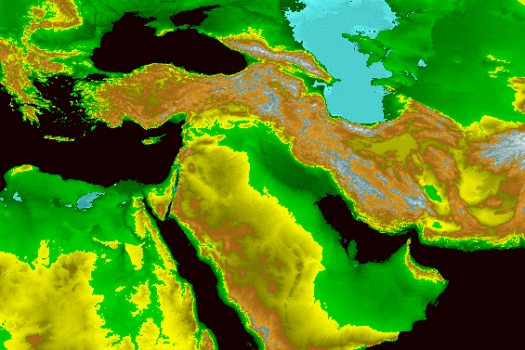
Medes
Babylon
Persians

Slide 16
Highlights of Jewish History
Hellenistic (Greek) Period – 333-323 BC.
356 BC – Alexander III (“the Great”) born in Pella in Macedonia, to King Philip II, who conquers all of Greece and region.
336 BC – Philip is assassinated; Alexander takes over at age 20.
334 BC – Alexander launches campaign against Persians, as planned by Philip.
334-323 BC – Alexander and his armies conquer most of the known world, but Alexander dies in Babylon on way back.

Slide 17
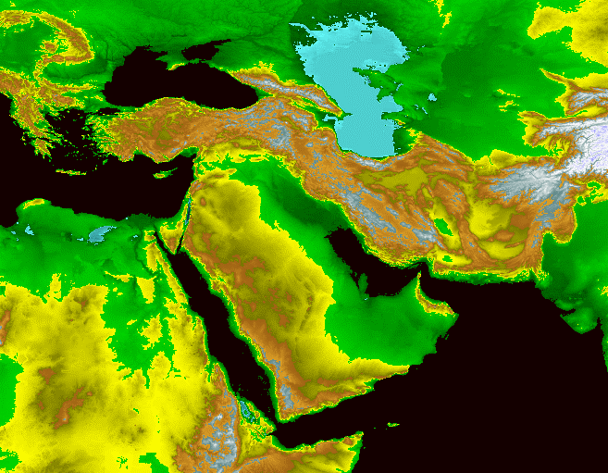
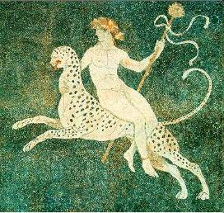
Alexander the Great

Slide 18
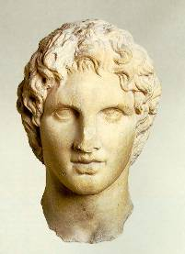
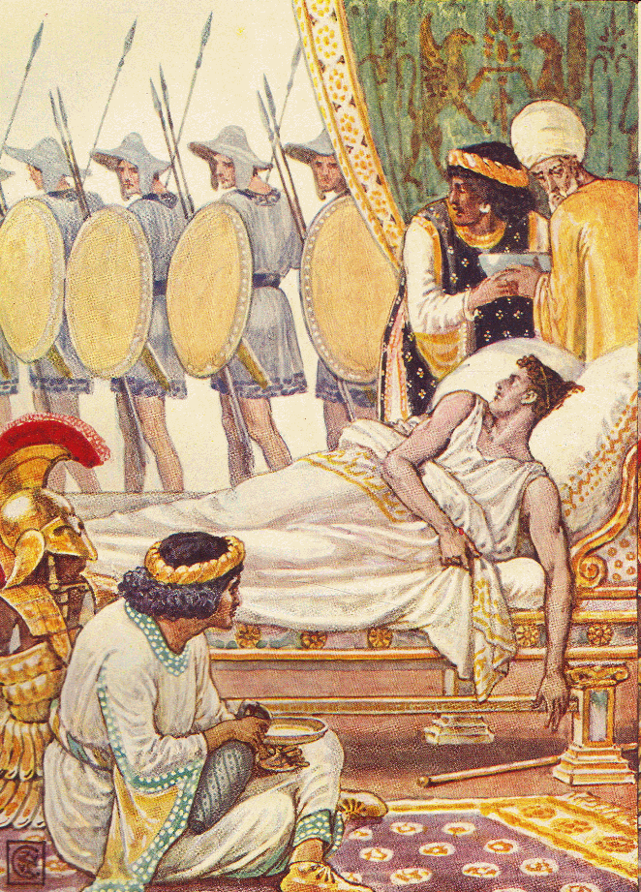
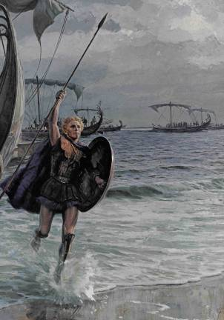

Slide 19
Highlights of Jewish History
323-320 BC - The War of the Diadoche.
Ptolemaic Period – 320-198 BC.
Jews remarkably free under Ptolemies.
A time of much assimilation of Jews into Hellenistic language, culture, arts, etc.
250 BC - Creation of Septuagint – Greek translation of the Hebrew Bible.
Seleucid Period – 198-166 BC.
198 BC – Seleucids take Palestine.
190 BC – Rome shows strength, defeating Seleucids at Magnesia and controlling Asia Minor
175 BC – Antiochus IV takes over Seleucids,.
168 BC – Antiochus tries to conquer Egypt.

Slide 20
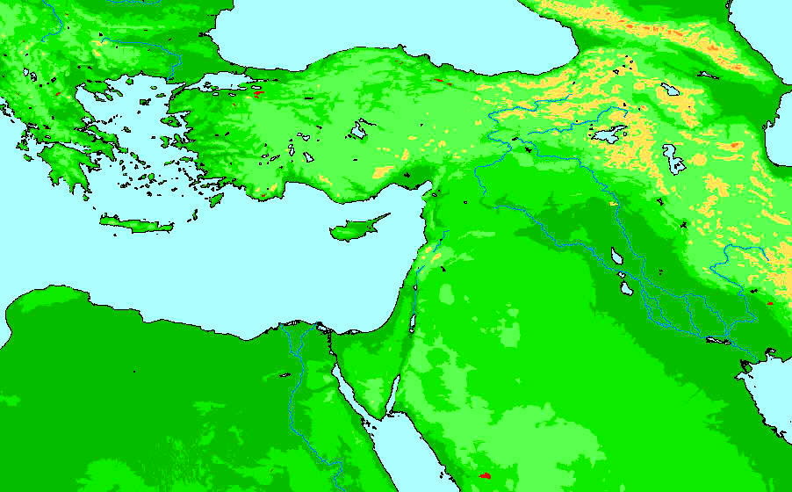
Lysimachus
Cassander
Seleucus
Ptolemy

Slide 21
Highlights of Jewish History
Seleucid Period (cont.) – 198-166 BC.
168 BC – returning from defeat in Egypt, Antiochus oppresses the Jews.
Jews could not assemble for prayer
Observance of the Sabbath forbidden
Possession of the Scriptures illegal
Circumcision was illegal
Dietary laws illegal
Pagan sacrifices mandated

Slide 22
Highlights of Jewish History
167-129 BC – Maccabean Period .
129-63 BC – Hasmonean Period.
63-37 BC – Roman Period.
37-4 BC – Reign of Herod the Great.

